Slide 1

PROJECT NO. 2
PROJECT TITLE:
“ TO IMPROVE THE CUSTOMER SATISFACTION SCORE (C-SAT SCORE) ”
Proprietary and Highly Confidential. 2020 Pursullence Global Business Solutions. All Rights Reserved
Notes:
PROJECT NO. 2 : TOPIC

Slide 2
DEFINE PHASE
Notes:
Project starts with First phase and that is Define Phase.

Slide 3
Scenario:
Mr. Shawn who works for Citizens Bank, The US based bank is the client of Horizon Services. Mr. Vinod Patil is the process owner for insurance consumer service process in Horizon Services. Mr. Shawn informed Mr. Vinod saying “Your service is not meeting the customer satisfaction level as mentioned in SLA. It is affecting my customer retention and I am loosing my customer because of improper customer care service. Please work on improving the customer satisfaction to level as mentioned in SLA or we will discontinue this contract with your company”. Now Mr. Vinod has to work on bringing CSAT level as per to the SLA.
Notes:
Hint: Read the business scenario before proceeding for project

Slide 4
Identification of VOC and Internal -External Customers
Parameters | Identified Area
Voice of Customer | “Your service is not meeting the customer satisfaction level as mentioned in SLA. It is affecting my customer retention and I am loosing my customer because of improper customer care service. Please work on improving the customer satisfaction to level mentioned in SLA or we will discontinue this contract with your company”
External Customer | Mr. Shawn and his Customers
Internal Customer | Mr. Vinod Patil
Critical to Quality | Compliance of CSAT score with SLA Target
Proprietary and Highly Confidential. 2020 Pursullence Global Business Solutions. All Rights Reserved
Notes:
Business Case Premise: Mr. Shawn who works for Citizens Bank, The US based bank is the client of Horizon Services. Mr. Vinod Patil is the process owner for insurance consumer service process in Horizon Services. Mr. Shawn informed Mr. Vinod saying “Your service is not meeting the customer satisfaction level as mentioned in SLA. It is affecting my customer retention and I am loosing my customer because of improper customer care service. Please work on improving the customer satisfaction to level as mentioned in SLA or we will discontinue this contract with your company”. Now Mr. Vinod has to work on bringing CSAT level as per to the SLA.

Slide 5
DATA COLLECTION PLAN
Notes:
Baseline/ Historical Data for Define Phase.

Slide 6
Discrete Data: 1-Proportion Test
Statistical Premise:
To check whether the defined Goal which is obtained from the baseline data is same as that of the goal of population.
Hypothesis
H_{o}: The proportion of CSAT score of population data is same as proportion for baseline data(p=po)
H_{a}: The proportion of CSAT score data is not same as that of population for baseline data(p≠po)
Proprietary and Highly Confidential. 2020 Pursullence Global Business Solutions. All Rights Reserved
Notes:
Hint
Step 1: Write the purpose of doing one proportion test for validation
Step 2: Write Null and Alternate Hypothesis

Slide 7
Discrete Data: 1-Proportion Test
Minitab Session Window output:
Descriptive Statistics
N Eve
Descriptive Statistics
N Event Sample p 95% CI for p
4550 2658 0.584176 (0.569695, 0.598549)
Test
Null hypothesis H₀: p = 0.58
Alternative hypothesis H₁: p ≠ 0.58
P-Value
0.568
Sample p 95% CI for p
4550 2658 0.584176 (0.569695, 0.598549)
Interpretation: Since p-value is greater than 0.05 we fail to reject null hypothesis. Hence proportion of csat score of population data is same as the proportion for baseline data.
Proprietary and Highly Confidential. 2020 Pursullence Global Business Solutions. All Rights Reserved
Notes:
Hint Cont.…
Step 3: Follow this Minitab Path to get the output : Stat> Basic Statistics> 1-Proportion test and paste the output in the blank space.
Step 4: Write interpretation and conclusion from the P-value.
In proportion test for hypothesized value use 0.4158.
Based on test performed draw the interpretation and conclusion.
The expected p-value from the test performed by you should be 0.988

Slide 8
PROJECT CHARTER

Slide 9
Business Case
Project Scope:
In- scope : This project is conducted for process 1.
Out-scope: Although it runs in location of Bangalore and Chennai ,but this project will be applicable only for process 1 of pune location.
Mr. Shawn who works for Citizens Bank, The US based bank is the client of Horizon Services. Mr. Vinod Patil is the process owner for insurance consumer service process in Horizon Services. Mr. Shawn informed Mr. Vinod saying “Your service is not meeting the customer satisfaction level as mentioned in SLA. It is affecting my customer retention and I am loosing my customer because of improper customer care service. Please work on improving the customer satisfaction to level mentioned in SLA or we will discontinue this contract with your company”. Now Mr. Vinod has to work on bringing CSAT level at par to the SLA.
QNS
In money
Client retention rate will increase with CSAT
Team Members
Role | Name | Org.
Black Belt/ Manager | Mr. Rajas Badgujar | Silverline Services
MBB/mentor/Sr. Manager | Mr. Rajesh Sabhrawal | Silverline Services
GB | Mr. Mohit Abhyankar | Silverline Services
Core Team | Mr. Suyog Mane, Mr. Abhay Chaddha | Silverline Services
Process Owner/ Champion | Mr. Vinod Patil | Silverline Services
SME | Mr. Nikhil Shah | Silverline Services
Finance | Ms. Hitesh Joshi | Silverline Services
Problem Statement- Out of 4550 observations of historical data 2658 have not met the CSAT score that is 58% of days which is severe.
Project Timeline
Phase | Start Date | End Date
Define | 1st January, 2020 | 31st March 2020
Measure | 1st April 2020 | 30th April 2020
Analyze | 1^{sh} May 2020 | 17th May 2020
Improve | 17th May 2020 | 15th June 2020
Control | 16th June 2020 | 30th July 2020
Goal Statement- To improve CSAT score from xxxx to yyyy till june 20
Proprietary and Highly Confidential. 2020 Pursullence Global Business Solutions. All Rights Reserved
Notes:
Use the following statement as business case:
Hints for Problem Statement:
Go through historical data
Find the average CSAT score in excel
Client has informed that there has to be minimum 3 as CSAT Score.
Please check and count the number of transactions that are less than 3 (Count the number of transactions with CSAT below 3.
Find the percentage of low CSAT.
Percentage of data point are below SLA
This will help you to find problem statement.
*Please refer our previous project to understand how problem statement is written.
Goal Statement:
Please prepare your ‘time binding’ statement based on improving current average to client expected CSAT score i.e. 3
Refer our previous project
In-scope/Out-scope
This project is conducted for process 1. Although it runs in location of Bangalore and Chennai, but this project will be applicable only for process 1 of Pune location.

Slide 10
SIPOC
i
SUPPLIER
INPUT
PROCESS
OUTPUT
CUSTOMER
Phone or email contact arrives at agents desk
SLA agreement
Laptop/Phone
Process individuals
Complain raised by customer
System generates ticket
Agent resolves the issue
If the issue is not solved pass it to supervisor / manager
The issue is resolved and notify the customer
Agent ask for customer satisfaction rating / score
Close the ticket
Issue is resolved
Customer seeking service
Proprietary and Highly Confidential. 2020 Pursullence Global Business Solutions. All Rights Reserved
Notes:
Hint:
Please refer process map given in next step (slide 10) and draw a high level process step.
Also refer our training manual and other project as a reference to identify each of the component of SIPOC
Insert the text box for each column to insert the answer.

Slide 11

Process Map:
Quality - Help Desk Process Map
Click here
Notes:
Hint:
Please refer the attached excel file for reference and clear view of process map
Observe the process map given and try to understand the flow of work.

Slide 12
COMMUNICATION PLAN (RACI MATRIX)
RACI | RESPONSIBLE PERSON | NAME OF PERSON
Responsible | Green Belt | Mr. Mohit Abhyankar
Approval | Manager | Mr. Rajas Badgujar
Consult | Sr. Manager | Mr. Rajesh Sabhrawal
Inform | Process Owner/MBB | Mr. Vinod Patil & Mr. Rajesh Sabhrawal
Review | RESPONSIBLE PERSON | NAME OF PERSON
Weekly | Responsible, Approval | Mr. Mohit Abhyankar & Mr. Rajas Badgujar
Fortnightly | Responsible, Approval & Consult | Mr. Mohit Abhyankar & Mr. Rajas Badgujar & Mr. Rajesh Sabhrawal
Monthly/Tollgate | Responsible, Approval, Consult & Inform | Mr. Mohit Abhyankar & Mr. Rajas Badgujar & Mr. Rajesh Sabhrawal & Mr. Vinod Patil
Notes:
Hint:
Please refer the TAT project for communication plan construction.
Take team members reference and their designation from project charter of this project to construct the matrix. (Slide 8)

Slide 13
MEASURE PHASE
Proprietary and Highly Confidential. 2020 Pursullence Global Business Solutions. All Rights Reserved

Slide 14
Operational Definition
CSAT score is the performance rating given by the end user for
respective query based on satisfactory resolution of the same.
Performance Standards
Unit Of Measure (UOM)
Every single query that receives CSAT score.
CSAT Score Given By Customer For Resolved Query
Opportunity
Every single query that receives CSAT score.
Data (Y) - Discrete
Data Source
System/(Helpdesk Ticketing tool)
Specification Limits & Target Value
USL – NA Target- 3
LSL –
1) Less than 3 ( for CSAT per customer query )
2) Less than 2.5 ( for Avg. CSAT score per Day )
Defective Definition:
Any query which has CSAT score < 3.
Proprietary and Highly Confidential. 2020 Pursullence Global Business Solutions. All Rights Reserved
Notes:
NOTE:- Performance Standards are already prepared and provided for your reference.

Slide 15
MEASUREMENT SYSTEM ANALYSIS
As Data Is Collected From System I.E. Data Is Generated From Helpdesk Ticketing Tool, So There Is No Need To Perform MSA
Proprietary and Highly Confidential. 2020 Pursullence Global Business Solutions. All Rights Reserved
Notes:
NOTE:- In this case there is no need to perform MSA as data collected is system driven.

Slide 16
List of Potential Causes
SR NO | CAUSES
1 | Shifts
2 | Unplanned call fluctuations
3 | Employee
4 | Educational background
5 | Gender
6 | Experience
7 | Calls Take Longer Than Expected
8 | Long after call work (wrap-up) time
9 | Server down issues
10 | Lack of knowledge to resolve
11 | Lack of confidence
12 | TL
SR NO | CAUSES
13 | % Of Rework Incidences In Given Day (% Of Total Rework Incidences / Total Requests Processed)
14 | Unscheduled meeting on given day
15 | % Unplanned leaves on given day
16 | Query Handling time (IN HRS)
17 | Unscheduled meeting on given day
18 | Handling multiple task
19 | % Unplanned leaves on given day
20 | No. Of rework incidences in given day
21 | Technical System issue
22 | Unwillingness to work
21 | Technical System issue
22 | Unwillingness to work
Proprietary and Highly Confidential. 2020 Pursullence Global Business Solutions. All Rights Reserved
Notes:
NOTE :- Given List of Potential Causes are obtained from Brainstorming sessions that were conducted during measure phase along with SME’s, Process Manager which are already provided for your reference.

Slide 17
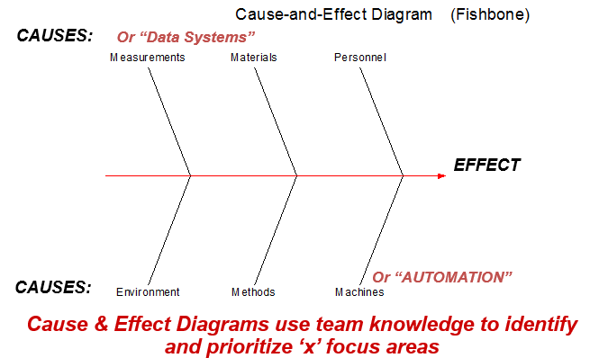
Ishikawa / Fishbone/ Cause & Effect Diagram
% of Rework Incidences in given day Handling multiple tasks
Unscheduled meeting on given day Query handling time
% of unplanned leaves on given day
Experience Educational background
Lack of confidence Unwillingness to work
Employee TL
Gender
) CSAT score(Y)
Unplanned call fluctuations Lack of knowledge to Long after call work Technical system issue
resolve (wrap up) time Server down issue
Shifts Call takes longer than
expected
Proprietary and Highly Confidential. 2020 Pursullence Global Business Solutions. All Rights Reserved
Notes:
HINT:-
Refer to slide ‘List of potential causes’.
From the available list of potential causes, segregate those causes into the categories of Fishbone diagram.
Categorize those causes into current slide of Fishbone diagram.
Note :- For eg- Education background is into personal category . Similarly do the remaining causes segregation.

Slide 18
C-I MATRIX
SR NO | CAUSES | TYPE
 |  | CONTROLLABLE/ NON CONTROLLABLE | HIGH/LOW IMPACTABLE | MEASUREABLE/NON-MEASUREABLE
1 | DAY OF WEEK | CONTROLLABLE | HIGH IMPACTABLE | MEASUREABLE
2 | EMPLOYEE | NON CONTROLLABLE | LOW IMPACTABLE | MEASUREABLE
3 | SHIFTS | CONTROLLABLE | HIGH IMPACTABLE | MEASUREABLE
4 | TYPES OF TASK COMPLEXITY | CONTROLLABLE | HIGH IMPACTABLE | MEASUREABLE
5 | EDUCATIONAL BACKGROUND | CONTROLLABLE | HIGH IMPACTABLE | MEASUREABLE
6 | EXPERIENCE | CONTROLLABLE | HIGH IMPACTABLE | MEASUREABLE
7 | QUERY HOLDING TIME | CONTROLLABLE | HIGH IMPACTABLE | MEASUREABLE
8 | GENDER | CONTROLLABLE | LOW IMPACTABLE | NON-MEASUREABLE
9 | TL | NON CONTROLLABLE | LOW IMPACTABLE | NON-MEASUREABLE
10 | QUERY HANDLING TIME | CONTROLLABLE | HIGH IMPACTABLE | MEASUREABLE
11 | NO. OF REWORK INCIDENCES IN GIVEN DAY | NON CONTROLLABLE | HIGH IMPACTABLE | NON-MEASUREABLE
12 | HANDLING MULTIPLE TASK | CONTROLLABLE | HIGH IMPACTABLE | MEASUREABLE
Proprietary and Highly Confidential. 2020 Pursullence Global Business Solutions. All Rights Reserved
Notes:
NOTE:- C- I matrix is already prepared and provided for your reference.

Slide 19
SAMPLING PLAN
Types of Sampling used :-
Random Sampling
In random sampling each sample has equal probability of chosen from population.
Stratified Sampling
It is a powerful sampling technique that allows sampled data to be separated into ‘subgroups’ called “strata”
Proprietary and Highly Confidential. 2020 Pursullence Global Business Solutions. All Rights Reserved
Notes:
NOTE:- Sampling Plan is already provided for your reference.

Slide 20
Data Collection Plan
CONTROLLABLE / NON CONTROLLABLE |  |  | OPERATIONAL DEFINATION | SAMPLING PLAN
What To Measure | Y Or X | Data Type | Operational Definition | What | Where | When | How Many
CSAT Score (Y) | Y | Discrete | CSAT score is the performance rating given by the end user for respective query based on satisfactory resolution of the same. | Collect database for CSAT score tickets. | Ticketing Tool, Excel database | 01/04/2020 to 30/04/2020 | Minimum 20 samples
Gender | X | Discrete | Which Gender (Male ,Female) |  | Excel database | 01/04/2020 to 30/04/2020
Experience/Tenure | X | Discrete | Which Tenure level |  | Excel database | 01/04/2020 to 30/04/2020
Team Lead | X | Discrete | Which TL (name wise- TL1, TL2) |  | Excel database | 01/04/2020 to 30/04/2020
Day of Week | X | Discrete | For Which day( Monday- Friday) |  | Excel database | 01/04/2020 to 30/04/2020
Shifts of Day | X | Discrete | For Which Shift (Morning, Afternoon, Night) |  | Excel database | 01/04/2020 to 30/04/2020
Educational Background (G/PG) | X | Discrete | Educational background (G/PG) |  | Excel database | 01/04/2020 to 30/04/2020
Proprietary and Highly Confidential. 2020 Pursullence Global Business Solutions. All Rights Reserved
Notes:
NOTE:- Data Collection Plan is already prepared and provided for your reference for both Y & X’s.

Slide 21
Data Collection Plan
CONTROLLABLE / NON CONTROLLABLE |  |  | OPERATIONAL DEFINATION | SAMPLING PLAN
What To Measure | Y Or X | Data Type | Operational Definition | What | Where | When | How Many
Query Holding time | X | Discrete | System generated hold time data | Collect database for CSAT score tickets. | Ticketing Tool, Excel database | 01/04/2020 to 30/04/2020 | Minimum 20 samples
Query Handling time | X | Discrete | System generated hold time data |  | Excel database | 01/04/2020 to 30/04/2020
Employee | X | Discrete | Name of employees |  | Excel database | 01/04/2020 to 30/04/2020
No. Of Rework Incidences In Given Day | X | Discrete | No of rework incidences per day |  | Excel database | 01/04/2020 to 30/04/2020
Handling Multiple Task | X | Discrete | No of multiple tasks handled per day |  | Excel database | 01/04/2020 to 30/04/2020
Proprietary and Highly Confidential. 2020 Pursullence Global Business Solutions. All Rights Reserved
Notes:
NOTE:- Data Collection Plan is already prepared and provided for your reference for both Y & X’s.

Slide 22
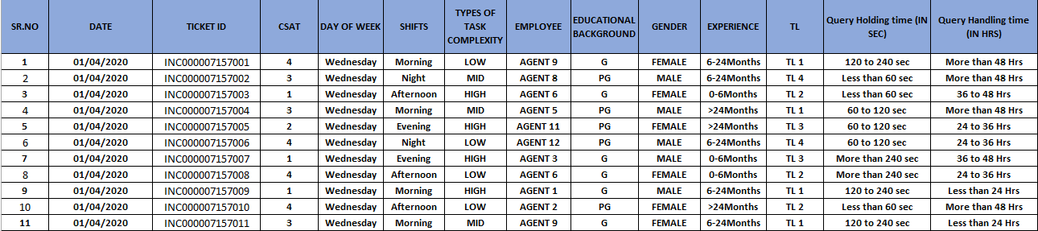
Measure Phase Data Collection in Excel – Part 1
Proprietary and Highly Confidential. 2020 Pursullence Global Business Solutions. All Rights Reserved
Notes:
Note:- Excel sheet data (Data 1) is embedded into slide for your reference

Slide 23
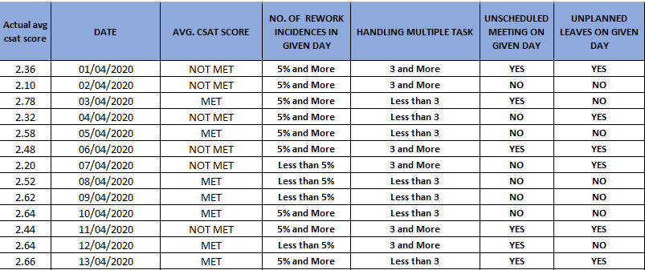
Measure Phase Data Collection in Excel – Part 2
Proprietary and Highly Confidential. 2020 Pursullence Global Business Solutions. All Rights Reserved
Notes:
Note:- Excel sheet data (data 2) is embedded into slide for your reference

Slide 24
CAPABILITY ANALYSIS-SIGMA VALUE CALCULATION
For Continuous Data: For Discrete Data:
FORMULA
FORMULA
LONG TERM SIGMA VALUE =
LONG TERM SIGMA VALUE =
NORMSINV(1-DPO)
NORMSINV(1-DPO)
SHORT TERM SIGMA VALUE =
LONG TERM VALUE + 1.5
Note: if the spec limit is an UPPER spec, the numerator is USL – Mean (or Target);
if the spec limit is a LOWER spec, the numerator is Mean (or Target) - LSL
Proprietary and Highly Confidential. 2020 Pursullence Global Business Solutions. All Rights Reserved
Notes:
Note:- CAPABILITY ANALYSIS-SIGMA VALUE CALCULATION
Formulas are already provided for your reference

Slide 25
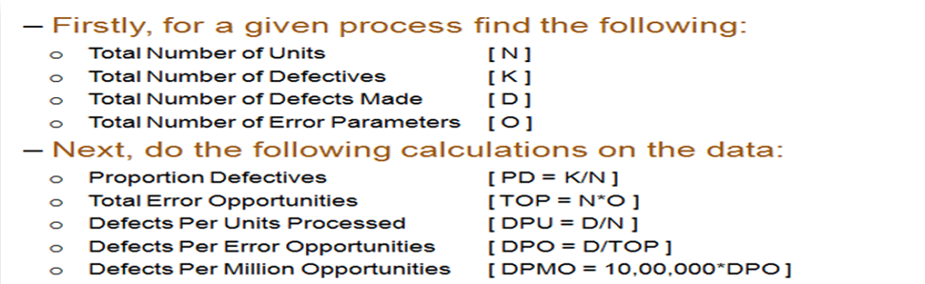
DETERMINE PROCESS CAPABILITY- DPMO
DPMO – Defects per million opportunities
For Sigma Value use Excel formula:
LONG TERM SIGMA VALUE (ZLT) | ZLT= normsinv( 1- DPO)
SHORT TERM SIGMA VALUE (ZST) | ZST= ZLT +1.5
Proprietary and Highly Confidential. 2020 Pursullence Global Business Solutions. All Rights Reserved
Notes:
DPMO CALCULATION :-
Formulas are already provided for your reference.
Y is discrete. Which sigma value will you select ( Long Term or Short Term) ?
Highlight that sigma value in red color on this slide.

Slide 26
CAPABILITY ANALYSIS
DEFECTIVE DEFINITION | CSAT score <3
TOTAL UNITS ( HINT: Take count of CSAT data from measure phase) | 1500
TOTAL OPPORTUNITIES ( HINT: Here defectives & opportunities are same) | 1500
DEFECTIVE ( HINT: How many defectives from CSAT data in measure phase are not meeting target <3 CSAT score.) | 740
DEFECTS/DEFECTIVES PER OPPORTUNITIES ( HINT: Using DPO formula calculate DPO value) | 0.49333
DEFECTIVES PER MILLION OPPORTUNITIES ( HINT: Using DPMO formula calculate value ) | 493333.33
LONG TERM SIGMA VALUE (ZLT) ( HINT: Use formula :- normsinv( 1- DPO) | 0.016
SHORT TERM SIGMA VALUE (ZST) ( HINT: N/A) | NA
Proprietary and Highly Confidential. 2020 Pursullence Global Business Solutions. All Rights Reserved
Notes:
HINT:-
Refer to the DPMO formulas & find the appropriate values of parameters of capability analysis.
2) CAPABILITY ANALYSIS: Solutions for Capability analysis are displayed in hint section.
1) Defective Definition - CSAT Score <3
2) Total Units - 1500
3) Total Opportunities - 1500
4) Defective - 740
5) Defects/Defectives Per Opportunities - 0.49333
6) Defectives Per Million Opportunities - 493333.33
7) LONG TERM SIGMA VALUE (ZLT) = normsinv ( 1- DPO) = 0.016

Slide 27
ANALYZE PHASE

Slide 28
GRAPHICAL ANALYSIS
Proprietary and Highly Confidential. 2020 Pursullence Global Business Solutions. All Rights Reserved

Slide 29
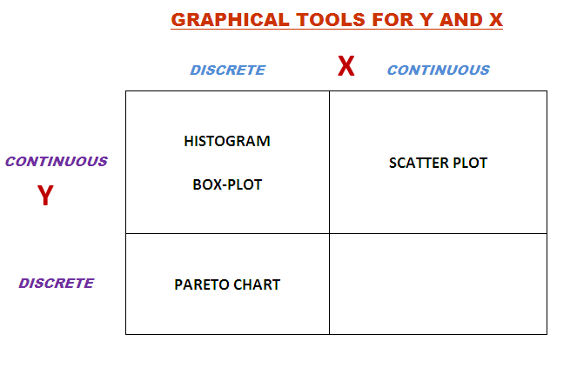
Summary chart for reference
Notes:
Hint: Please use the above table to understand which graph can implemented based on the type of data.

Slide 30
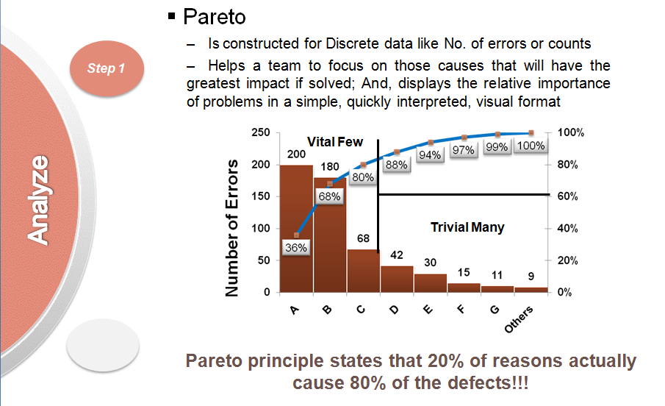
Pareto Tests
Is constructed for Discrete data like No. of errors or counts
Helps a team to focus on those causes that will have the greatest impact if solved; And, displays the relative importance of problems in a simple, quickly interpreted, visual format.
Proprietary and Highly Confidential. 2020 Pursullence Global Business Solutions. All Rights Reserved
Notes:
Hint:- Pareto Chart description is already provided for your reference.

Slide 31
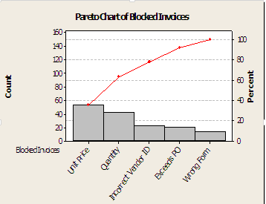
Pareto
SAMPLE GRAPH:
Discrete data
Categorize defects
Summarize defect counts
Application:
Advantages:
Can use text or numerical data as input
Creates prioritized bar chart
Cumulative percentage line (red) shows the added contribution of each category
Disadvantages:
None – this is the primary graphical tool for discrete data
Proprietary and Highly Confidential. 2020 Pursullence Global Business Solutions. All Rights Reserved
Notes:
Hint :- Pareto Chart description is already provided for your reference.

Slide 32
Pareto Chart
Output:- Pareto Chart of ‘SHIFTS’ by ‘CSAT Score’
Interpretation: Here from pareto chart we can observe that night shift has more incidences of not meeting CSAT score
Proprietary and Highly Confidential. 2020 Pursullence Global Business Solutions. All Rights Reserved
Notes:
Hint:
Step 1: Follow this Minitab Path to get the output : Stat->Quality Tools –> Pareto Chart
Step 2: Write interpretation by reading the chart

Slide 33
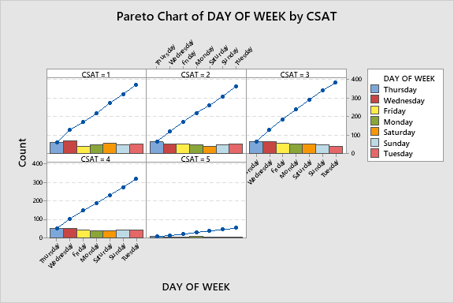
Pareto Chart
Output:- Pareto Chart of ‘Day of the week’ by ‘CSAT Score’
PASTE MINITAB GRAPH HERE
Interpretation: Here from pareto chart we can observe that Thursday has more incidences of not meeting CSAT Score
Proprietary and Highly Confidential. 2020 Pursullence Global Business Solutions. All Rights Reserved
Notes:
Hint:
Step 1: Select the data and perform the pareto test by referring the steps done to get pareto chart as done in previous slide.
Step 2: Follow this Minitab Path to get the output : Stat->Quality Tools –> Pareto Chart
Step 3: Paste the pareto chart in the given box and write interpretation by reading the chart

Slide 34
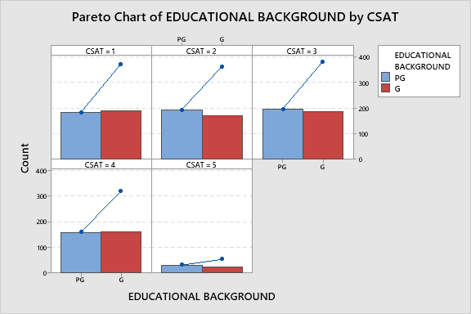
Pareto Chart
Output:- Pareto Chart of ‘Educational Background’ by ‘CSAT Score’
PASTE MINITAB GRAPH HERE
Interpretation: Here from Pareto chart we can observe that people with PG educational background has more incidences of not meeting CSAT Score.
Proprietary and Highly Confidential. 2020 Pursullence Global Business Solutions. All Rights Reserved
Notes:
Hint:
Step 1: Select the data and perform the pareto test by referring the steps done to get pareto chart as done in previous slide.
Step 2: Follow this Minitab Path to get the output : Stat->Quality Tools –> Pareto Chart
Step 3: Paste the pareto chart in the given box and write interpretation by reading the chart

Slide 35
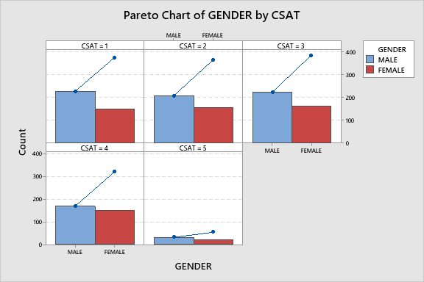
Pareto Chart
Output:- Pareto Chart of ‘Gender’ by ‘CSAT Score’
PASTE MINITAB GRAPH HERE
Interpretation: Here from Pareto chart we can observe that male employees has more incidences of not meeting CSAT Score.
Proprietary and Highly Confidential. 2020 Pursullence Global Business Solutions. All Rights Reserved
Notes:
Hint:
Step 1: Select the data and perform the pareto test by referring the steps done to get pareto chart as done in previous slide.
Step 2: Follow this Minitab Path to get the output : Stat->Quality Tools –> Pareto Chart
Step 3: Paste the pareto chart in the given box and write interpretation by reading the chart

Slide 36
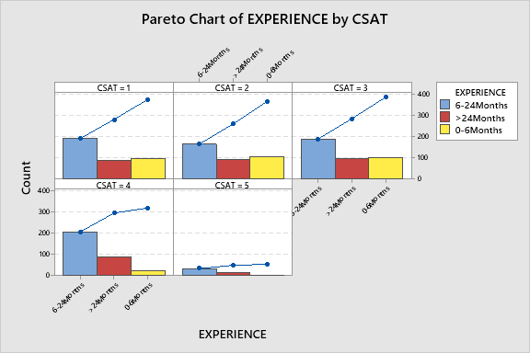
Pareto Chart
Output:- Pareto Chart of ‘Experience’ by ‘CSAT Score’
PASTE MINITAB GRAPH HERE
Interpretation: Here from Pareto Chart we can observe that Experience (6-24) months has more incidences of not meeting CSAT Score.
Proprietary and Highly Confidential. 2020 Pursullence Global Business Solutions. All Rights Reserved
Notes:
Hint:
Step 1: Select the data and perform the pareto test by referring the steps done to get pareto chart as done in previous slide.
Step 2: Follow this Minitab Path to get the output : Stat->Quality Tools –> Pareto Chart
Step 3: Paste the pareto chart in the given box and write interpretation by reading the chart

Slide 37
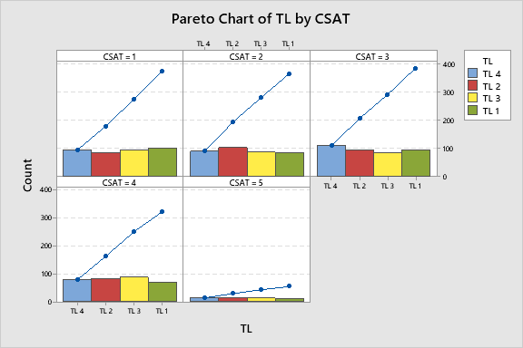
Pareto Chart
Output:- Pareto Chart of ‘TL’ by ‘CSAT Score’
PASTE MINITAB GRAPH HERE
Interpretation: Here from Pareto Chart we can observe that fourth team lead has more incidences of not meeting CSAT Score
Proprietary and Highly Confidential. 2020 Pursullence Global Business Solutions. All Rights Reserved
Notes:
Hint:
Step 1: Select the data and perform the pareto test by referring the steps done to get pareto chart as done in previous slide.
Step 2: Follow this Minitab Path to get the output : Stat->Quality Tools –> Pareto Chart
Step 3: Paste the pareto chart in the given box and write interpretation by reading the chart

Slide 38
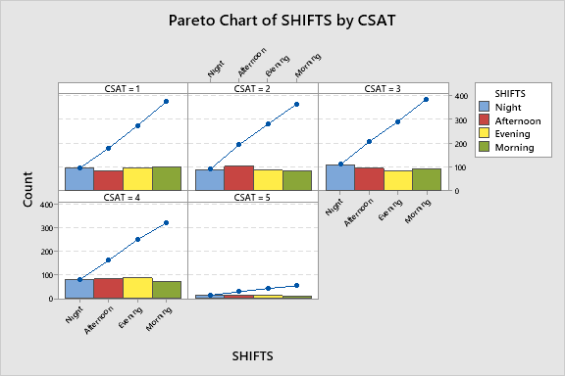
Pareto Chart
Output:- Pareto Chart of ‘SHIFTS’ by ‘CSAT Score’
PASTE MINITAB GRAPH HERE
Interpretation: Here from Pareto Chart we can observe that night shifts has more incidences of not meeting CSAT Score
Proprietary and Highly Confidential. 2020 Pursullence Global Business Solutions. All Rights Reserved
Notes:
Hint:
Step 1: Select the data and perform the pareto test by referring the steps done to get pareto chart as done in previous slide.
Step 2: Follow this Minitab Path to get the output : Stat->Quality Tools –> Pareto Chart
Step 3: Paste the pareto chart in the given box and write interpretation by reading the chart

Slide 39
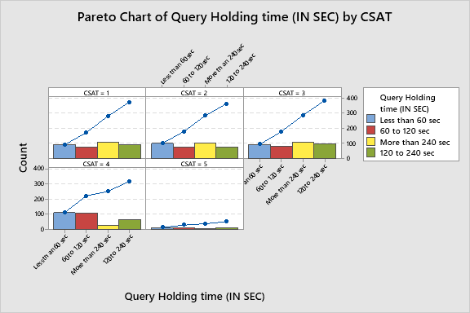
Pareto Chart
Output:- Pareto Chart of ‘Query Holding time (IN SEC)’ by ‘CSAT Score’
PASTE MINITAB GRAPH HERE
Interpretation: Here from Pareto Chart we can observe that Query holding time less than 60 sec has more incidences of not meeting CSAT Score
Proprietary and Highly Confidential. 2020 Pursullence Global Business Solutions. All Rights Reserved
Notes:
Hint:
Step 1: Select the data and perform the pareto test by referring the steps done to get pareto chart as done in previous slide.
Step 2: Follow this Minitab Path to get the output : Stat->Quality Tools –> Pareto Chart
Step 3: Paste the pareto chart in the given box and write interpretation by reading the chart

Slide 40
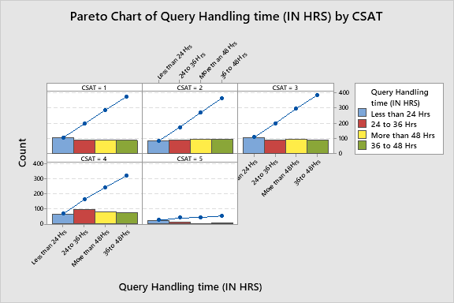
Pareto Chart
Output:- Pareto Chart of ‘Query Holding time (IN HRS)’ by ‘CSAT Score’
PASTE MINITAB GRAPH HERE
Interpretation: Here from Pareto Chart we can observe that Query holding time less than 24 hours has more incidences of not meeting CSAT Score
Proprietary and Highly Confidential. 2020 Pursullence Global Business Solutions. All Rights Reserved
Notes:
Hint:
Step 1: Select the data and perform the pareto test by referring the steps done to get pareto chart as done in previous slide.
Step 2: Follow this Minitab Path to get the output : Stat->Quality Tools –> Pareto Chart
Step 3: Paste the pareto chart in the given box and write interpretation by reading the chart

Slide 41
INFERENTIAL TEST
Proprietary and Highly Confidential. 2020 Pursullence Global Business Solutions. All Rights Reserved

Slide 42
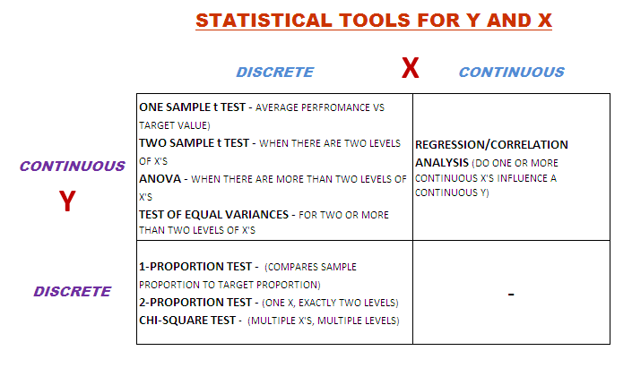
Summary chart for reference
Notes:
Statistical tool selection guide for your reference.

Slide 43
Statistical Tools Selection and expected results
For CSAT value in rating between 1-5
Y (PROBLEM) | X (CAUSES) | DESCRIPTIVE TEST | INFERENTIAL TEST | EXPECTED P-VALUE | POST HOC TEST | SIGNIFICANT SUB-CAUSE (OBSERVED VALUE>EXPECTED VALUE)
CSAT | DAY OF WEEK | PARETO | CHI-SQUARE TEST | 0.964 | NOT APPLICABLE | -
CSAT | SHIFT | PARETO | CHI-SQUARE TEST | 0.738 | NOT APPLICABLE | -
CSAT | TYPES OF TASK COMPLEXITY | PARETO | CHI-SQUARE TEST | 0 | GOODNESS OF FIT | LOW
CSAT | EDUCATIONAL BACKGROUND | PARETO | CHI-SQUARE TEST | 0.647 | NOT APPLICABLE
CSAT | GENDER | PARETO | CHI-SQUARE TEST | 0.332 | NOT APPLICABLE
CSAT | EXPERIENCE | PARETO | CHI-SQUARE TEST | 0 | GOODNESS OF FIT | 6-24 MONTHS
CSAT | TEAM LEAD | PARETO | CHI-SQUARE TEST | 0.738 | NOT APPLICABLE
CSAT | QUERY HOLDING TIME (IN SEC) | PARETO | CHI-SQUARE TEST | 0 | GOODNESS OF FIT | LESS THAN 60 SEC
CSAT | QUERY HOLDING TIME (IN HR) | PARETO | CHI-SQUARE TEST | 0.007 | GOODNESS OF FIT | 24-36 HRS
Proprietary and Highly Confidential. 2020 Pursullence Global Business Solutions. All Rights Reserved
Notes:
Hint:
Before proceeding kindly read the above table understand the steps to be followed.
How to read the table:
Column 1: Name of Y (Problem)
Column 2: Name of X (Causes)
Column 3: Based on Y data type and X data type the descriptive test that is to be performed is mentioned
Column 4: Based on Y data type and X data type the inferential test that is to be performed is mentioned
Column 5: After performing the test, this column gives hint of respective p-value of ‘x’
Column 6: Now if p-value is less than 0.05 the cause is significant, so if it is true then this column tell whether post hoc test is applicable or not.
Column 7: If post hoc test is performed then which sub cause of significant cause has more impact is shown here. (Note: If the Observed value > Expected Value then that sub cause is significant.)

Slide 44
Chi-Square Test
When is a Chi-Square (χ²) Test Used?
A Chi-Square Test compares the proportion of discrete ‘y’ responses for multiple ‘level’s of an ‘x’
The Chi-Square Test answers the question: It is observed in graphical analysis that proportions of ‘Y’ across sub-categories of ‘X’ are not same.
Is above result occurred, statistically significant enough i.e. applicable to whole population ? or,
ii. Is above result occurred by just random chance i.e. applicable only to current sample of ‘Y’?
H_{o} : The proportions of ‘Y’ across sub-categories of ‘X’ are same i.e. X has no impact on Y.
H_{a} : The proportions of ‘Y’ across sub-categories of ‘X’ are not same i.e. X has impact on Y.
Note: Chi-Square Tests can be used for ‘x’s with 2 OR MORE levels
Proprietary and Highly Confidential. 2020 Pursullence Global Business Solutions. All Rights Reserved
Notes:
Chi Square test theory.

Slide 45
Chi Square Test for ‘Day of week’
HYPOTHETICAL PREMISE
Purpose:
To check whether day of week has impact on CSAT score.
HYPOTHESIS:
H_{o}: Day of week has no impact on CSAT score.
H_{a}: Day of week has impact on CSAT score.
Proprietary and Highly Confidential. 2020 Pursullence Global Business Solutions. All Rights Reserved
Notes:
Steps to perform Chi Square Test:
Step 1: Write the purpose of doing Chi Square test for validation
Step 2: Write Null and Alternate Hypothesis

Slide 46
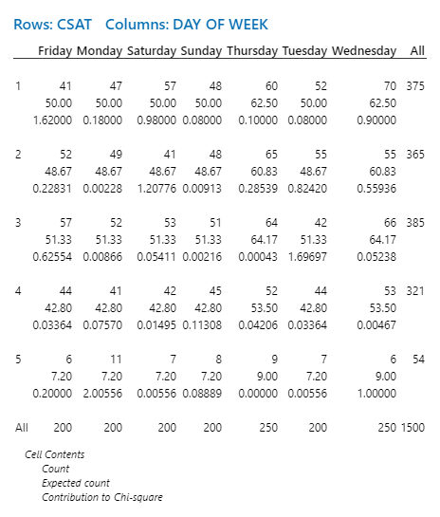
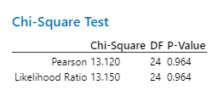
Output of Chi-Square Test for ‘Day of the week’
Minitab Session Window output:
Interpretation: since p-value is >0.05 we accept null hypothesis .Hence impact of day of week on CSAT score is not statistically significant
Proprietary and Highly Confidential. 2020 Pursullence Global Business Solutions. All Rights Reserved
Notes:
Step 3 Follow this Minitab Path to get the output : Stat -->Tables --> Cross Tabulation and Chi Squared Test and paste the output in the blank space.
Step 4: Write interpretation and conclusion from the P-value.

Slide 47
Chi Square Test for type of ‘Task complexity’
HYPOTHETICAL PREMISE
Purpose:
To check whether task complexity has impact on CSAT score.
HYPOTHESIS:
H_{o}: Task complexity has no impact on CSAT score.
H_{a}: Task complexity has impact on CSAT score.
Proprietary and Highly Confidential. 2020 Pursullence Global Business Solutions. All Rights Reserved
Notes:
Steps to perform Chi Square Test:
Step 1: Write the purpose of doing Chi Square test for validation
Step 2: Write Null and Alternate Hypothesis

Slide 48
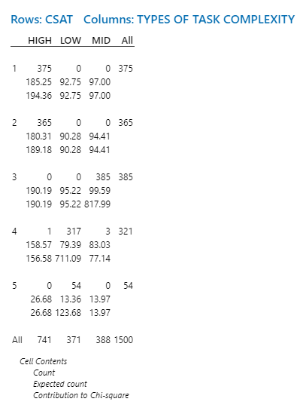
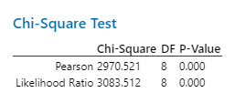
Output of Chi-Square Test for ‘Task complexity’
Minitab Session Window output:
Interpretation: since p-value is <0.05 we reject null hypothesis .Hence impact of task complexity on CSAT score is statistically significant.
Proprietary and Highly Confidential. 2020 Pursullence Global Business Solutions. All Rights Reserved
Notes:
Step 1: Follow this Minitab Path to get the output : Stat -->Tables --> Cross Tabulation and Chi Squared Test and paste the output in the blank space.
Step 2: Write interpretation and conclusion from the P-value.

Slide 49
Chi Square Test for ‘Educational background’
HYPOTHETICAL PREMISE
Purpose:
To check whether educational background has impact on CSAT score.
HYPOTHESIS:
H_{o}: Educational background has no impact on CSAT score
H_{a}: Educational background has impact on CSAT score
Proprietary and Highly Confidential. 2020 Pursullence Global Business Solutions. All Rights Reserved
Notes:
Steps to perform Chi Square Test:
Step 1: Write the purpose of doing Chi Square test for validation
Step 2: Write Null and Alternate Hypothesis

Slide 50
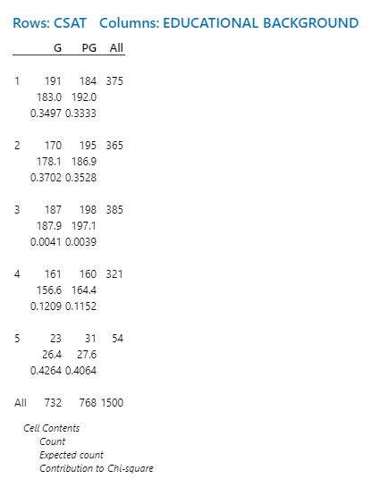
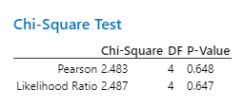
Output of Chi-Square Test for ‘Educational background’
Minitab Session Window output:
interpretation: since p value is >0.05 we fail to reject the null hypothesis hence there is no impact of Educational background on CSAT score.
Proprietary and Highly Confidential. 2020 Pursullence Global Business Solutions. All Rights Reserved
Notes:
Step 1: Follow this Minitab Path to get the output : Stat -->Tables --> Cross Tabulation and Chi Squared Test and paste the output in the blank space.
Step 2: Write interpretation and conclusion from the P-value.

Slide 51
Chi Square Test for ‘Gender’
HYPOTHETICAL PREMISE
Purpose:
To check whether gender has impact on CSAT score.
HYPOTHESIS:
H_{o}: Gender has no impact on CSAT score.
H_{a}: Gender has no impact on CSAT score.
Proprietary and Highly Confidential. 2020 Pursullence Global Business Solutions. All Rights Reserved
Notes:
Steps to perform Chi Square Test:
Step 1: Write the purpose of doing Chi Square test for validation
Step 2: Write Null and Alternate Hypothesis

Slide 52
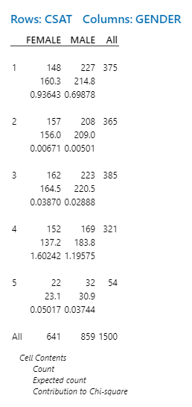
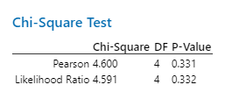
Output of Chi-Square Test for ‘Gender’
Minitab Session Window output:
Interpretation: since p-value is <0.05 we reject null hypothesis .Hence impact of gender on CSAT score is statistically significant
Proprietary and Highly Confidential. 2020 Pursullence Global Business Solutions. All Rights Reserved
Notes:
Step 1: Follow this Minitab Path to get the output : Stat -->Tables --> Cross Tabulation and Chi Squared Test and paste the output in the blank space.
Step 2: Write interpretation and conclusion from the P-value.

Slide 53
Chi Square Test for ‘Experience’
HYPOTHETICAL PREMISE
Purpose:
To check whether experience has impact on CSAT score.
HYPOTHESIS:
H_{o}: Experience has no impact on CSAT score.
H_{a}: Experience has impact on CSAT score.
Proprietary and Highly Confidential. 2020 Pursullence Global Business Solutions. All Rights Reserved
Notes:
Steps to perform Chi Square Test:
Step 1: Write the purpose of doing Chi Square test for validation
Step 2: Write Null and Alternate Hypothesis

Slide 54
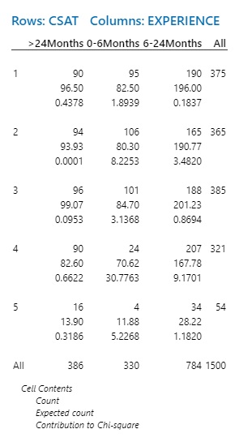
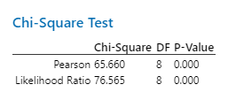
Output of Chi-Square Test ‘Experience’
Minitab Session Window output:
Interpretation: since p-value is <0.05 we reject null hypothesis .Hence impact of experience on CSAT score is statistically significant
Proprietary and Highly Confidential. 2020 Pursullence Global Business Solutions. All Rights Reserved
Notes:
Step 1: Follow this Minitab Path to get the output : Stat -->Tables --> Cross Tabulation and Chi Squared Test and paste the output in the blank space.
Step 2: Write interpretation and conclusion from the P-value.

Slide 55
Chi Square Test for ‘TL’
HYPOTHETICAL PREMISE
Purpose:
To check whether TL has impact on CSAT score
HYPOTHESIS:
H_{o}: TL has no impact on CSAT score.
H_{a}: TL has impact on CSAT score.
Proprietary and Highly Confidential. 2020 Pursullence Global Business Solutions. All Rights Reserved
Notes:
Steps to perform Chi Square Test:
Step 1: Write the purpose of doing Chi Square test for validation
Step 2: Write Null and Alternate Hypothesis

Slide 56
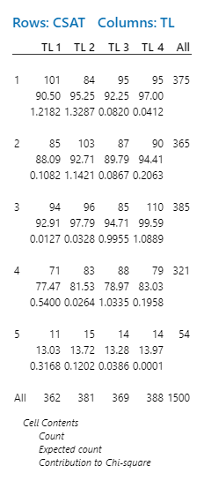
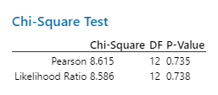
Output of Chi-Square Test ‘TL’
Minitab Session Window output:
Interpretation: Since p value is >0.05 we fail to reject the null hypothesis. There is no impact of TL on CSAT score.
Proprietary and Highly Confidential. 2020 Pursullence Global Business Solutions. All Rights Reserved
Notes:
Step 1: Follow this Minitab Path to get the output : Stat -->Tables --> Cross Tabulation and Chi Squared Test and paste the output in the blank space.
Step 2: Write interpretation and conclusion from the P-value.

Slide 57
Chi Square Test for
‘Query Holding time (IN SEC)’
HYPOTHETICAL PREMISE
Purpose:
To check whether Query holding time (in sec) has impact on CSAT score
HYPOTHESIS:
H_{o}: Query holding time(in sec) has no impact on CSAT score.
H_{a}: Query holding time(in sec) has impact on CSAT score
Proprietary and Highly Confidential. 2020 Pursullence Global Business Solutions. All Rights Reserved
Notes:
Steps to perform Chi Square Test:
Step 1: Write the purpose of doing Chi Square test for validation
Step 2: Write Null and Alternate Hypothesis

Slide 58
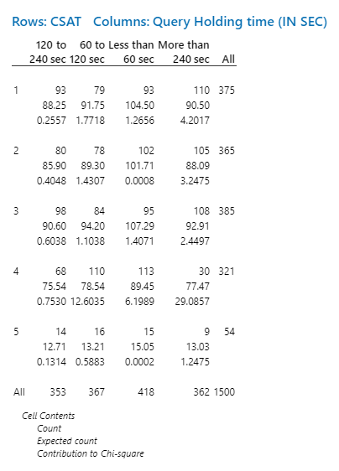
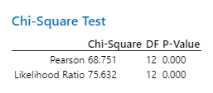
Output of Chi-Square Test for
‘Query Holding time (IN SEC)’
Minitab Session Window output:
Interpretation: Since p value is <0.05 we fail to reject the null hypothesis. There is impact of Query holding time(in sec) on CSAT score.
Proprietary and Highly Confidential. 2020 Pursullence Global Business Solutions. All Rights Reserved
Notes:
Step 1: Follow this Minitab Path to get the output : Stat -->Tables --> Cross Tabulation and Chi Squared Test and paste the output in the blank space.
Step 2: Write interpretation and conclusion from the P-value.

Slide 59
Chi Square Test for
‘Query Holding time (IN HRS)’
HYPOTHETICAL PREMISE
Purpose:
To check whether Query holding time (in hrs) has impact on CSAT score
HYPOTHESIS:
H_{o}: Query holding time(in hrs) has no impact on CSAT score.
H_{a}: Query holding time(in hrs) has no impact on CSAT score.
Proprietary and Highly Confidential. 2020 Pursullence Global Business Solutions. All Rights Reserved
Notes:
Steps to perform Chi Square Test:
Step 1: Write the purpose of doing Chi Square test for validation
Step 2: Write Null and Alternate Hypothesis

Slide 60
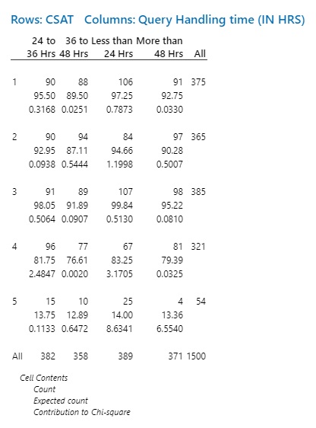

Output of Chi-Square Test for
‘Query Holding time (IN HRS)’
Minitab Session Window output:
Interpretation: : Since p value is <0.05 we fail to reject the null hypothesis. There is impact of Query holding time(in hrs) on CSAT score
Proprietary and Highly Confidential. 2020 Pursullence Global Business Solutions. All Rights Reserved
Notes:
Step 1: Follow this Minitab Path to get the output : Stat -->Tables --> Cross Tabulation and Chi Squared Test and paste the output in the blank space.
Step 2: Write interpretation and conclusion from the P-value.

Slide 61
Chi-Square Tests Goodness of fit
When is a Chi-Square (χ²) Goodness of fit Test Used ?
When one find positive result for chi square test, ie.when p value < 0.05, it indicates that an Impact of “ X” on “Y” is statistically significant. Then, one need to find out which sublevel of “X” has significant impact on “Y”.
Chi-Square (χ²) Goodness of fit Test validate which sublevel of X has significant impact upon Y.
Proprietary and Highly Confidential. 2020 Pursullence Global Business Solutions. All Rights Reserved
Notes:
Chi square test goodness of fit theory for your reference.

Slide 62
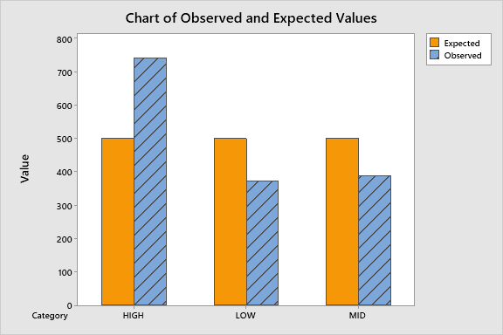
Graphical Output of Goodness of Fit Test for
‘Type of Task Complexity’
Minitab Session Window output:
PASTE MINITAB OUTPUT HERE
Interpretation: Here we can see that the observed frequency/value of CSAT score is higher than expected value of CSAT score for High level Task Complexity. Higher Observed value than expected value is visible for high level task complexity. Thus High level task complexity has significant impact on CSAT Score.
Proprietary and Highly Confidential. 2020 Pursullence Global Business Solutions. All Rights Reserved
Notes:
Hint:
Steps to get Observed & Expected Frequency graph of Goodness of fit test:
Step 1: Follow this Minitab Path to get the output : Stat ->Tables -> Chi-Square Goodness of fit test and paste the Observed & Expected Frequency graph in the blank space.
Step 2: Write interpretation from the Graph.

Slide 63
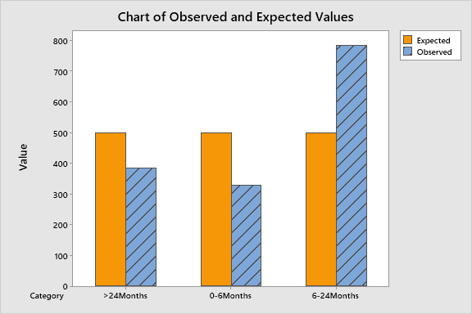
Graphical Output of Goodness of Fit Test for
for ‘Experience’
Minitab Session Window output:
PASTE MINITAB OUTPUT HERE
Interpretation: Here we can see that the observed frequency/value of CSAT score is higher than expected value of CSAT score for 6-24 months of experience. Higher Observed value than expected value is visible 6-24 months of experience. Thus 6-24 months of experience has significant impact on CSAT score.
Proprietary and Highly Confidential. 2020 Pursullence Global Business Solutions. All Rights Reserved
Notes:
Hint:
Steps to get Observed & Expected Frequency graph of Goodness of fit test:
Step 1: Follow this Minitab Path to get the output : Stat ->Tables -> Chi-Square Goodness of fit test and paste the Observed & Expected Frequency graph in the blank space.
Step 2: Write interpretation from the Graph.

Slide 64
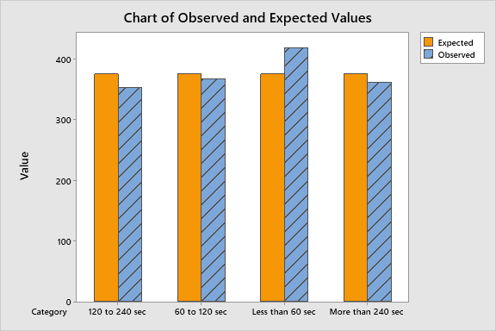
Graphical Output of Goodness of Fit Test for
‘Query Holding time (IN SEC)’
Minitab Session Window output:
PASTE MINITAB OUTPUT HERE
Interpretation: Here we can see that the observed frequency/value of CSAT score is higher than expected value of CSAT score for less than 60 sec of query holding time. Higher Observed value than expected value is visible for 60 sec of query holding time. Thus 60 sec of query holding time has significant impact on CSAT score.
Proprietary and Highly Confidential. 2020 Pursullence Global Business Solutions. All Rights Reserved
Notes:
Hint:
Steps to get Observed & Expected Frequency graph of Goodness of fit test:
Step 1: Follow this Minitab Path to get the output : Stat ->Tables -> Chi-Square Goodness of fit test and paste the Observed & Expected Frequency graph in the blank space.
Step 2: Write interpretation from the Graph.

Slide 65
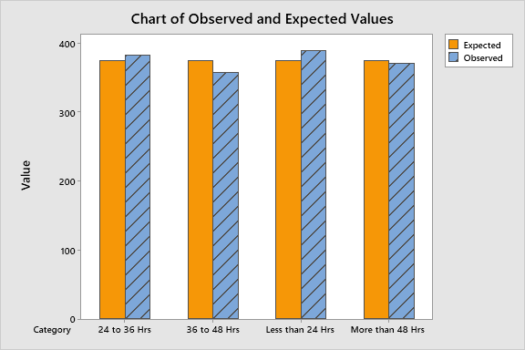
Graphical Output of Goodness of Fit Test for
‘Query Holding time (IN HRS)’
Minitab Session Window output:
PASTE MINITAB OUTPUT HERE
Interpretation: Here we can see that the observed frequency/value of CSAT Score is higher than expected value of CSAT Score for less than 24 hours of query holding time(in hrs). Higher Observed value than expected value is visible for 24 hours of query holding time(in hrs). Thus 24 hours of query holding time has significant impact on CSAT score.
Proprietary and Highly Confidential. 2020 Pursullence Global Business Solutions. All Rights Reserved
Notes:
Hint:
Steps to get Observed & Expected Frequency graph of Goodness of fit test:
Step 1: Follow this Minitab Path to get the output : Stat ->Tables -> Chi-Square Goodness of fit test and paste the Observed & Expected Frequency graph in the blank space.
Step 2: Write interpretation from the Graph.

Slide 66
GRAPHICAL TOOLS FOR Y & X
Proprietary and Highly Confidential. 2020 Pursullence Global Business Solutions. All Rights Reserved
Notes:
Hint:-
Graphical Tools table for Y & X type of data is already provided for your reference.

Slide 67
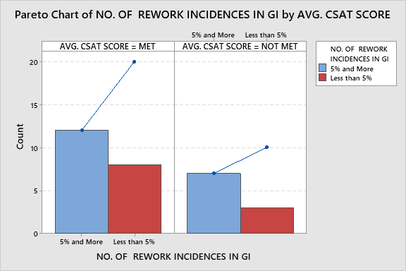
Pareto Chart
Output:- Pareto Chart of ‘CSAT Score’ by ‘ NO. OF REWORK INCIDENCES IN GIVEN DAY’
Interpretation: Here from Pareto Chart we can observe that 5% and more no of rework incidences in given day of not meeting CSAT Score.
Proprietary and Highly Confidential. 2020 Pursullence Global Business Solutions. All Rights Reserved
Notes:
Hint:-
Steps to perform Pareto chart
Step 1: Follow this Minitab Path to get the output : Stat> Quality Tools> Pareto Chart
Step 2: Paste the output of Pareto chart from minitab in the blank space.
Step 3: Write interpretation from pareto chart.

Slide 68
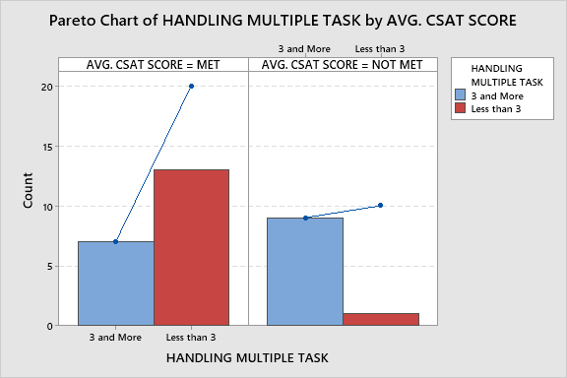
Pareto Chart
Output:- Pareto Chart of ‘CSAT Score’ by ‘HANDLING MULTIPLE TASK’
Interpretation: Here from Pareto Chart we can observe that 3 and more handling multiple tasks has more incidences of not meeting CSAT Score.
Proprietary and Highly Confidential. 2020 Pursullence Global Business Solutions. All Rights Reserved
Notes:
Hint:-
Steps to perform Pareto chart
Step 1: Follow this Minitab Path to get the output : Stat> Quality Tools> Pareto Chart
Step 2: Paste the output of Pareto chart from minitab in the blank space.
Step 3: Write interpretation from for pareto chart.

Slide 69
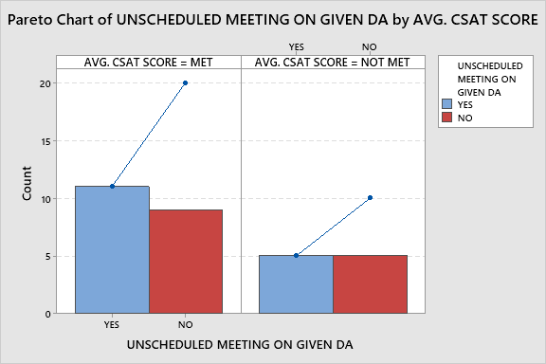
Pareto Chart
Output:- Pareto Chart of ‘CSAT Score’ by ‘UNSCHEDULED MEETING ON GIVEN DAY’
Interpretation: Here from Pareto Chart we can observe that yes and no of unscheduled meeting on given day have same no of not meeting CSAT Score.
Proprietary and Highly Confidential. 2020 Pursullence Global Business Solutions. All Rights Reserved
Notes:
Hint:-
Steps to perform Pareto chart
Step 1: Follow this Minitab Path to get the output : Stat> Quality Tools> Pareto Chart
Step 2: Paste the output of Pareto chart from minitab in the blank space.
Step 3: Write interpretation from pareto chart.

Slide 70
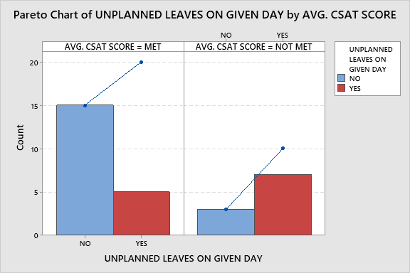
Pareto Chart
Output:- Pareto Chart of ‘CSAT Score’ by ‘ % UNPLANNED LEAVES ON GIVEN DAY’
Interpretation: Here from Pareto Chart we can observe that yes of % unplanned leaves has more incidences of not meeting CSAT Score.
Proprietary and Highly Confidential. 2020 Pursullence Global Business Solutions. All Rights Reserved
Notes:
Hint:-
Steps to perform Pareto chart
Step 1: Follow this Minitab Path to get the output : Stat> Quality Tools> Pareto Chart
Step 2: Paste the output of Pareto chart from minitab in the blank space.
Step 3: Write interpretation from pareto chart.

Slide 71
STATISTICAL TEST TABLE FOR Y& X TYPE OF DATA
Proprietary and Highly Confidential. 2020 Pursullence Global Business Solutions. All Rights Reserved
Notes:
Hint:-
Statistical test table for Y & X type of data is already provided for your reference.

Slide 72
2-Proportion Test
When is a 2-Proportion Test Used?
A 2-Proportion Test compares the proportion of discrete ‘y’ for two ‘level’s of an ‘x’. Difference between Chi Square test and 2 proportion test is- whenever there are more than 2 levels / categories of Xs, we will use Chi Square test. And, whenever 2 levels / categories of Xs, we will use 2 proportion test.
The 2-Proportion Test answers the question: It is observed in graphical analysis that proportions of ‘Y’ across 2 sub-categories of ‘X’ are not same.
Is above observation statistically significant enough i.e. applicable to whole population ? or,
ii. Is above observation occurred by random chance i.e. applicable only to random sample of ‘Y’?
Hypothesis:
H_{o} : The proportions of ‘Y’ across 2 sub-categories of ‘X’ are same i.e. X has no impact on Y
H_{a} : The proportions of ‘Y’ across 2 sub-categories of ‘X’ are not same. i.e. X has impact on Y
Proprietary and Highly Confidential. 2020 Pursullence Global Business Solutions. All Rights Reserved
Notes:
2 Proportion test theory for your reference.

Slide 73
2 PROPORTION TEST FOR ‘NO. OF REWORK INCIDENCES / DAY’
HYPOTHETICAL PREMISE
Purpose:
To validate whether there is any impact of no of rework incidences/day on CSAT Score
Hypothesis:
H_{o}: No of rework incidences has no impact on CSAT Score
H_{a}: No of rework incidences has no impact on CSAT Score
Proprietary and Highly Confidential. 2020 Pursullence Global Business Solutions. All Rights Reserved
Notes:
Hint:-
Steps to perform 2 P Test :-
Step 1: Follow this Minitab Path to get the output : Stat> Basic Statistics> 2-Proportion test
Step 2: Write Purpose of 2P test.
Step 3: Write Ho & Ha hypothesis

Slide 74
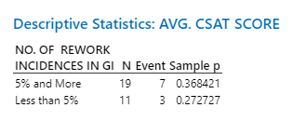
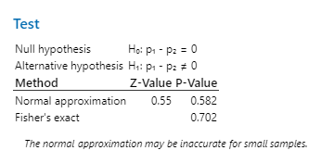
Output of 2 P Test For ‘No. Of Rework Incidences/Day’
Minitab Session Window output:
Interpretation: Since p-value is > 0.05, we fail to reject null hypothesis. Hence, There is no Impact of “ No of rework incidences/day” on CSAT score.
Proprietary and Highly Confidential. 2020 Pursullence Global Business Solutions. All Rights Reserved
Notes:
Hint :-
Step 1: Paste output of 2 P test obtained from minitab in the blank space.
Step 2: Write interpretation and conclusion from the P-value.

Slide 75
2 PROPORTION TEST FOR ‘HANDLING MULTIPLE TASK’
HYPOTHETICAL PREMISE
Purpose:
To validate whether there is any impact of handling multiple tasks on CSAT Score
Hypothesis:
H_{o}: Handling multiple tasks has no impact on CSAT Score.
H_{a}: Handling multiple tasks has impact on CSAT Score.
Proprietary and Highly Confidential. 2020 Pursullence Global Business Solutions. All Rights Reserved
Notes:
Hint :-
Steps to perform 2 P Test :-
Step 1: Follow this Minitab Path to get the output : Stat> Basic Statistics> 2-Proportion test
Step 2: Write Purpose of 2P test.
Step 3: Write Ho & Ha hypothesis

Slide 76
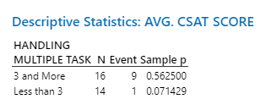

Output of 2 P Test For ‘HANDLING MULTIPLE TASK’
Minitab Session Window output:
Interpretation: Since p-value<0.05 we reject the null hypothesis. There is impact of handling multiple tasks on CSAT Score.
Proprietary and Highly Confidential. 2020 Pursullence Global Business Solutions. All Rights Reserved
Notes:
Hint:-
Step 1: Paste output of 2 P test obtained from minitab in the blank space.
Step 2: Write interpretation and conclusion from the P-value.

Slide 77
2 PROPORTION TEST FOR ‘UNSCHEDULED MEETING ON GIVEN DAY’
HYPOTHETICAL PREMISE
Purpose:
To validate whether there is any impact of unscheduled meetings on CSAT Score.
Hypothesis:
H_{o}: Unscheduled meetings has no impact on CSAT Score.
H_{a}: Unscheduled meetings has impact on CSAT Score.
Proprietary and Highly Confidential. 2020 Pursullence Global Business Solutions. All Rights Reserved
Notes:
Hint:-
Steps to perform 2 P Test :-
Step 1: Follow this Minitab Path to get the output : Stat> Basic Statistics> 2-Proportion test
Step 2: Write Purpose of 2P test.
Step 3: Write Ho & Ha hypothesis

Slide 78
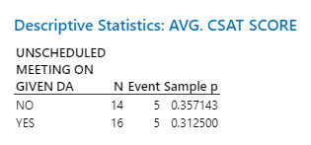
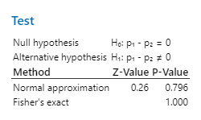
Output of 2 P Test For ‘UNSCHEDULED MEETING ON GIVEN DAY’
Minitab Session Window output:
Interpretation: Since p-value is >0.05 we fail to reject the null hypothesis hence there is no impact of unscheduled meeting on CSAT score.
Proprietary and Highly Confidential. 2020 Pursullence Global Business Solutions. All Rights Reserved
Notes:
Hint:-
Step 1: Paste output of 2 P test obtained from minitab in the blank space.
Step 2: Write interpretation and conclusion from the P-value.

Slide 79
2 PROPORTION TEST FOR ‘% UNPLANNED LEAVES ON GIVEN DAY’
HYPOTHETICAL PREMISE
Purpose:
To validate whether there is any impact of % of unplanned leaves on CSAT Score
Hypothesis:
H_{o}: % Unplanned leaves has no impact on CSAT Score
H_{a}: % Unplanned leaves has impact on CSAT Score
Proprietary and Highly Confidential. 2020 Pursullence Global Business Solutions. All Rights Reserved
Notes:
Hint:-
Steps to perform 2 P Test :-
Step 1: Follow this Minitab Path to get the output : Stat> Basic Statistics> 2-Proportion test
Step 2: Write Purpose of 2P test.
Step 3: Write Ho & Ha hypothesis

Slide 80
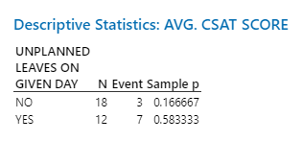

Output of 2 P Test For ‘% UNPLANNED LEAVES ON GIVEN DAY’
Minitab Session Window output:
Interpretation: Since p-value<0.05 we reject the null hypothesis. There is impact of handling multiple tasks on CSAT Score.
Proprietary and Highly Confidential. 2020 Pursullence Global Business Solutions. All Rights Reserved
Notes:
Hint:-
Step 1: Paste output of 2 P test obtained from minitab in the blank space.
Step 2: Write interpretation and conclusion from the P-value.

Slide 81
SUMMARY TABLE
Statistical Tools Selection and expected results
Y (PROBLEM) | X (CAUSES) | DESCRIPTIVE TEST | INFERENTIAL TEST | EXPPECTED P-VALUE | POST HOC TEST | SIGNIFICANT SUBCAUSE (OBSERVED >EXPECTED)
CSAT | NO. OF REWORK INCIDENCES IN GIVEN DAY | PARETO | TWO PROPORTION TEST | 0.582 | NOT APPLICABLE | -
CSAT | HANDLING MULTIPLE TASK | PARETO | TWO PROPORTION TEST | 0.007 | GOODNESS OF FIT | 3 & MORE
CSAT | UNSCHEDULED MEETING ON GIVEN DAY | PARETO | TWO PROPORTION TEST | 0.796 | NOT APPLICABLE | -
CSAT | % UNPLANNED LEAVES ON GIVEN DAY | PARETO | TWO PROPORTION TEST | 0.01 | GOODNESS OF FIT | YES
Proprietary and Highly Confidential. 2020 Pursullence Global Business Solutions. All Rights Reserved
Notes:
Hint:-
Final Summary table is already provided for Y (CSAT) & X’s.

Slide 82
IMPROVE PHASE
Proprietary and Highly Confidential. 2020 Pursullence Global Business Solutions. All Rights Reserved

Slide 83
Solution Brainstorming
SR. NO | Significant X’s | Solutions 1 | Solutions 2 | Solutions 3 | Solutions 4
1 | Type of task complexity | Analyze past 3 months task distribution and increase high complex task distribution to experienced members by 20-30% over next3 weeks.
2 | Employee Experience /Tenure | Arrange a meeting with mid experienced staff and discuss their challenges and best practices with them and incorporate adequate best practices. | Arrange refresh training sessions for mid experienced professionals. | Develop and improvement plan for consistent low performers | Standardize technicians / engineers performance with frequent online tests every week that ensure employee know details of the process and error patterns. And map their performance with appraisals.
3 | Query Holding time (IN SEC) | Manage the calls in proper way.
Proprietary and Highly Confidential. 2020 Pursullence Global Business Solutions. All Rights Reserved
Notes:
Note: Solution Brainstorming is done by Pursullence.

Slide 84
Solution Brainstorming- Continued
SR. NO | Significant X’s | Solutions 1 | Solutions 2 | Solutions 3 | Solutions 4
4 | Query Handling time (IN HRS) | Get Proper understanding of whole the process.it helps to reduce the query handling time.
5 | Handling Multiple Task | Conduct a task handling assessment for next 3-4 days with few case staff from exp /mid exp / freshers and understand time consumption patterns across volume driven (actual tasks), trigger driven(meetings driven) and % time consumptions on work on total time spent in office. | Ensure task switching reduces by 20-30% at fresher's level by ensuring minimal task switching for fresher's as low as 1 task a day.
6 | % Unplanned Leaves On Given Day | Analyze unplanned leaves pattern restructure appraisal policy with negative points on unplanned leaves. | Encourage team planned leaves before time.
Proprietary and Highly Confidential. 2020 Pursullence Global Business Solutions. All Rights Reserved
Notes:
Note: Solution Brainstorming is done by Pursullence.

Slide 85
Solution Refining
Significant | Ideas | Impact | Low Cost | Feasible to Deploy | Authority Consent | Solutions Priority Index
Xs
1. Type of task complexity | Analyze past 3 months task distribution and increase high complex task distribution to experienced members by 20-30% over next3 weeks. | 3 | 3 | 3 | 3 | 81
2. Employee Experience /Tenure | Arrange a meeting with mid experienced staff and discuss their challenges and best practices with them and incorporate adequate best practices. | 3 | 3 | 3 | 3 | 81
 | Arrange refresh training sessions for mid experienced professionals. | 3 | 2 | 3 | 2 | 36
 | Develop an improvement plan for consistent low performers | 3 | 3 | 2 | 3 | 54
 | Standardize technicians / engineers performance with frequent online tests every week that ensure employee know details of the process and error patterns. And map their performance with appraisals. | 3 | 2 | 2 | 3 | 36
3. Query Holding time (IN SEC) | Develop personal performance tracker for bottom 20% performers. | 3 | 3 | 3 | 3 | 81
Proprietary and Highly Confidential. 2020 Pursullence Global Business Solutions. All Rights Reserved
Notes:
Note: Solution Refining is done by Pursullence.

Slide 86
Solution Refining- Continued
Significant | Ideas | Impact | Low Cost | Feasible to Deploy | Authority Consent | Solutions Priority Index
Xs
4. Query Handling time (IN HRS) | Arrenge monthly training program. | 3 | 3 | 3 | 3 | 81
 | Develop personal performance tracker for bottom 20% performers. | 3 | 3 | 3 | 3 | 81
5. Handling Multiple Task | Conduct a task handling assessment for next 3-4 days with few trial case staff from exp/mid exp / freshers and understand time consumption patterns across volume driven (actual tasks), trigger driven(meetings driven) and % time consumptions on work on total time spent in office. | 3 | 2 | 2 | 3 | 36
 | Ensure task switching reduces by 20-30% at freshers level by ensuring minimal task switching for freshers as low as 1 task a day. | 3 | 3 | 3 | 3 | 81
6. % Unplanned leaves | Analyse unplanned leaves pattern restructure appraisal policy with negative points on unplanned leaves. | 3 | 3 | 3 | 3 | 81
 | Encourage team planned leaves before time. | 3 | 3 | 3 | 3 | 81
Proprietary and Highly Confidential. 2020 Pursullence Global Business Solutions. All Rights Reserved
Notes:
Note: Solution Refining is done by Pursullence.

Slide 87
Pilot Phase Planning and Data Collection
PHASE I : SOLUTIONS SENSITIZATION ( 1stMay 2020 to 10th May 2020)
From process 1 of Account 1 of Horizon Services, bottom 10% resources are planned to analyze based on historical data. Pilot project will be implemented upon bottom 10% performers from each experience tenure level.
Project problem will be discussed with them, important causes and probable solutions need to be communicated to them in a small session. Probable challenges to implement solutions will be discussed and 10 days timeline from 1stMay 2020 to 10th May 2020 will be allocated for solutions sensitization.
Process TL will track the challenges to deploy solutions and best practices sharing on daily basis.
LSSGB project leader and AM will review solution implementation status on alternate days and ensure smooth implementation of solutions and will provide adequate support.
PHASE II : ASSESSMENT OF SOLUTION STANDARDIZATION : ( 11th May 2020 to 12th May 2020)
1. On 11th May 2020, a small test will be conducted among pilot participants to assess their understanding of new changes or solutions. If test will assure that > 90% participants’ scores are satisfactory, then we will confirm that solution standardization is accomplished. Update will be communicated to authorities/process owner.
PHASE III : IMPROVE PHASE DATA COLLECTION AND IMPROVEMENT VALIDATION : (17th May, 2020 until 30th June 2020 )
Improve phase data collection will commence from Monday, 17th May, 2020 until 30th June 2020 . If Improvement will be achieved, it will be validated based on adequate statistical tests and capability analysis. Results will be shared with authorities and improvement will be assessed monetarily.
Proprietary and Highly Confidential. 2020 Pursullence Global Business Solutions. All Rights Reserved
Notes:
Note: Pilot Phase Planning and Data Collection is done by Pursullence.

Slide 88
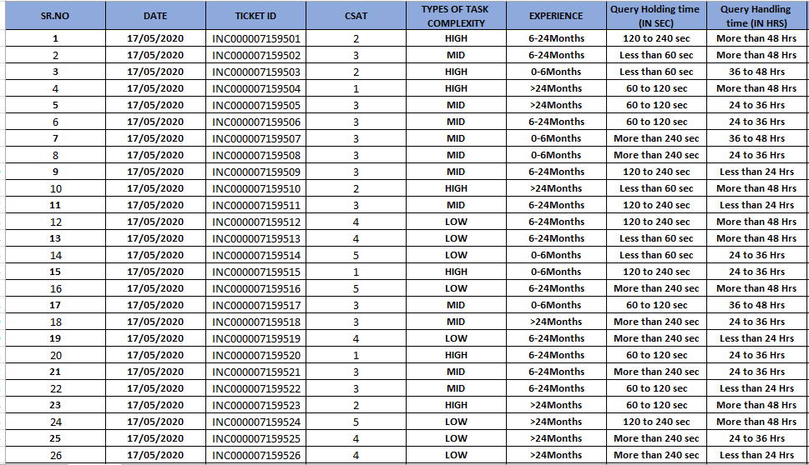
Improve Phase: Data Collection
Proprietary and Highly Confidential. 2020 Pursullence Global Business Solutions. All Rights Reserved
Notes:
Hint: Here we provide the data collection sheet in excel format. Here we collect data for significant X’s and Y i.e. CSAT score.

Slide 89
Validation Test – 2 Proportion Test
Purpose:
To check whether improvement is accomplished in improve phase.
Hypothesis
H_{o} : The proportion of meeting CSAT Score is same in improve phase and in measure phase.
Ha: The proportion of meeting CSAT Score in improve phase is more than in measure phase.
Proprietary and Highly Confidential. 2020 Pursullence Global Business Solutions. All Rights Reserved
Notes:
Steps to perform 2 proportion test:
Step 1: Write the purpose of doing 2 proportion test for validation (For this, you can refer TAT project)
Step 2: Write Null and Alternate Hypothesis.

Slide 90
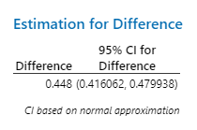
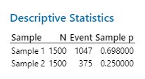
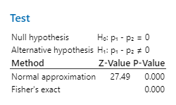
Validation Test – 2 Proportion Test
Minitab Output:
Interpretation: Since p-value is <0.05 (alpha value) we accept the null hypothesis that the proportion of meeting CSAT Score in improve phase is more than in measure phase.
Conclusion: Since p-value is <0.05 (alpha value ).Hence the proportion of CSAT Scoreis accomplished for total population..
Proprietary and Highly Confidential. 2020 Pursullence Global Business Solutions. All Rights Reserved
Notes:
Steps to perform 2 proportion test continued:
Step 3: Follow this Minitab Path to get the output : Stat> Basic Statistics> 2-Proportion test and paste the output in the blank space.
Step 4: Write interpretation and conclusion from the P-value.
Hint:
The expected p-value from the test performed by you should be 0.000

Slide 91
Validation Test – 1 Proportion Test
Purpose:
To validate whether the defined goal is not met and applicable for total population in improve phase
Hypothesis
H_{o} : The proportion of not meeting CSAT score in improve phase is same as in measure phase.(p=po)
Ha: The proportion of not meeting CSAT Score in improve phase is less than in measure phase.(p<po)
Proprietary and Highly Confidential. 2020 Pursullence Global Business Solutions. All Rights Reserved
Notes:
Steps to perform 1 proportion test:
Step 1: Write the purpose of doing one proportion test for validation (For this, you can refer TAT project)
Step 2: Write Null and Alternate Hypothesis.

Slide 92
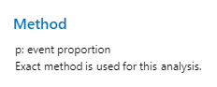


Validation Test – 1 Proportion Test
Minitab Output:
Interpretation: Since p-value is <0.05 we reject null hypothesis .Hence proportion of not meeting CSAT Score in improve phase is less than in measure phase.
Conclusion: Since p-value is <0.05 (alpha value) we can conclude that proportion of not meeting CSAT Score is achieved set target (ie <58%) Hence we can infer that improvement goal is achieved in improve phase.
Proprietary and Highly Confidential. 2020 Pursullence Global Business Solutions. All Rights Reserved
Notes:
Steps to perform 1 proportion test continued:
Step 3: Follow this Minitab Path to get the output : Stat> Basic Statistics> 1-Proportion test and paste the output in the blank space.
Step 4: Write interpretation and conclusion from the P-value.
Hint:
In control phase for 1 proportion test use 0.60 as hypothesized value.
The expected p-value from the test performed by you should be 1.000

Slide 93
Capability Test
Summary Table:
DEFECTIVE DEFINITION | CSAT Score<3
TOTAL UNITS ( HINT: Take count of CSAT data from improve phase) | 1500
TOTAL OPPORTUNITIES (HINT: Here defectives & opportunities are same) | 1500
DEFECTIVE ( HINT: How many defectives from CSAT data in improve phase are not meeting target <3 CSAT score.) | 453
DEFECTS/DEFECTIVES PER OPPORTUNITIES (HINT: Using DPO formula calculate DPO value) | 0.30
DEFECTIVES PER MILLION OPPORTUNITIES ( HINT: Using DPMO formula calculate value ) | 302000
LONG TERM SIGMA VALUE (ZLT) (HINT: Use formula :- normsinv( 1- DPO) | 0.52
SHORT TERM SIGMA VALUE (ZST) (HINT: N/A) | NA
Interpretation:
Proprietary and Highly Confidential. 2020 Pursullence Global Business Solutions. All Rights Reserved
Notes:
HINT:-
Refer to the formulas provided in measure phase & find the appropriate values of parameters of capability analysis.
2) CAPABILITY ANALYSIS: Solutions for Capability analysis are displayed in hint section.
Defective Definition - CSAT Score <3
Total Units - 1500
Total Opportunities - 1500
Defective - 453
DPO = Defects/Total Opportunities - 0.30
DPMO = Defectives Per Million Opportunities – 302000
LONG TERM SIGMA VALUE (ZLT) = normsinv ( 1- DPO) I.E normsinv( 1-0.30) = 0.52

Slide 94
Phase-wise Sigma Value Comparison
Summarized Graph:
PHASE | LONG TERM SIGMA VALUE | AVG
MEASURE | 0.016 71999 | 0.267688461
IMPROVE | 0.518656932 | 0.267688461
Interpretation: If we observe the graph ,the long term sigma value was 0.01671999 in measure phase ,it improved to 0.518656932 in improve phase so there is a improvement observed in long term sigma value from measure phase to improve phase.
Proprietary and Highly Confidential. 2020 Pursullence Global Business Solutions. All Rights Reserved
Notes:
Here, you have to compute sigma value for each phase (i.e. for Measure, Improve & Control) and draw a simple bar chart with average line to compare phase-wise sigma value.
Steps to draw a bar chart for Phase-wise comparison of Sigma Value (Long Term):
First step is copy or write the sigma value for measure phase in the table given on this slide and this value you have obtained previously.
Second is write sigma value for improve phase which is been obtained in the control phase itself.
And once we have sigma values for two phases, then compute average sigma value of these two and write it in the third column in all the three cells.
In excel draw a simple bar graph with average line.
Last step is, write interpretation from the graph.
Note: For interpretation refer previous project of TAT Reduction.

Slide 95
Validation Test for X’s Improvement
Minitab Output of Chi Square Test for Y and X
Minitab path : Stat>Tables>Chi Square test
Chi-Square Test for Association: CSAT, TYPES OF TASK COMPLEXITY
Rows: CSAT Columns: TYPES OF TASK COMPLEXITY
HIGH LOW MID All
1 163 0 0 163
49.2 68.8 45.0
2 290 0 0 290
87.6 122.4 80.0
3 0 0 414 414
125.0 174.7 114.3
4 0 395 0 395
119.3 166.7 109.0
5 0 238 0 238
71.9 100.4 65.7
All 453 633 414 1500
Cell Contents: Count
Expected count
Pearson Chi-Square = 3000.000, DF = 8, P-Value = 0.000
Likelihood Ratio Chi-Square = 3242.950, DF = 8, P-Value = 0.000
Interpretation: Impact of “Type of task complexity” on CSAT is statistically significant.
Proprietary and Highly Confidential. 2020 Pursullence Global Business Solutions. All Rights Reserved
Notes:
Hint: here we need to check is there any impact of X’s on Y – CSAT after implementing the solutions. So this validation test for X’s.
For 1st X variable test is done by Pursullence and for other variables you need to do it. (other significant X’s)

Slide 96


Validation Test for X’s Improvement
Minitab Output of Chi Square Test for Y and X
Interpretation: Impact of CSAT Score on “Experience” is not significant.
Proprietary and Highly Confidential. 2020 Pursullence Global Business Solutions. All Rights Reserved
Notes:
Hint: Apply appropriate test for other X’s to validate the result. Print the test output here and write appropriate interpretation using p-value.

Slide 97


Validation Test for X’s Improvement
Minitab Output of Chi Square Test for Y and X
Interpretation: Impact of CSAT Score on “Query holding time(in sec)” is not significant.
Proprietary and Highly Confidential. 2020 Pursullence Global Business Solutions. All Rights Reserved
Notes:
Hint: Apply appropriate test for other X’s to validate the result. Print the test output here and write appropriate interpretation using p-value.

Slide 98


Validation Test for X’s Improvement
Minitab Output of Chi Square Test for Y and X
Chi-Square Test
Chi-Square DF P-Value
Pearson 5.166 12 0.952
Likelihood Ratio 5.199 12 0.951
Interpretation: Impact of CSAT Score on “Query holding time(in hrs)” is not significant.
Proprietary and Highly Confidential. 2020 Pursullence Global Business Solutions. All Rights Reserved
Notes:
Hint: Apply appropriate test for other X’s to validate the result. Print the test output here and write appropriate interpretation using p-value.

Slide 99
Validation Test for Improvement Summary
SR. NO. | Y | X | TEST | P-VALUE | INTERPRETATION
1 | CSAT | TYPES OF TASK COMPLEXITY | CHI SQUARE TEST | 0.000 | Since p-value is < 0.05, we reject null hypothesis. Hence, There is a Impact of “Types of Task Complexity” On CSAT.
2 | CSAT | EXPERIENCE | CHI SQUARE TEST | 0.702 | Since p-value is >0.05 we accept the null hypothesis .Hence ,there is no impact of “Experience “ on CSAT.
3 | CSAT | QUERY HOLDING TIME(IN SEC) | CHI SQUARE TEST | 0.509 | Since p-value is >0.05 we accept the null hypothesis .Hence ,there is no impact of “Query holding time(in sec)“ on CSAT.
4 | CSAT | QUERY HOLDING TIME (IN HRS) | CHI SQUARE TEST | 0.951 | Since p-value is >0.05 we accept the null hypothesis .Hence ,there is no impact of “Query holding time(in hrs)“ on CSAT.
Proprietary and Highly Confidential. 2020 Pursullence Global Business Solutions. All Rights Reserved
Notes:
Hint: Fill the table and write appropriate interpretation using p-value.

Slide 100

Updated Process Map
Proprietary and Highly Confidential. 2020 Pursullence Global Business Solutions. All Rights Reserved
Notes:
After implementing the solutions, we need to update the process map.

Slide 101
CONTROL PHASE
Proprietary and Highly Confidential. 2020 Pursullence Global Business Solutions. All Rights Reserved
Notes:
Note: Now, control phase begins from this slide.

Slide 102

FMEA
Proprietary and Highly Confidential. 2020 Pursullence Global Business Solutions. All Rights Reserved
Notes:
First we will do FMEA in Control phase.
Note: Failure Mode Effect Analysis is done by Pursullence. For your reference excel file is embedded into this slide. To open the file, double click on the excel icon given on the upper right corner.

Slide 103

FMEA Continued…
Proprietary and Highly Confidential. 2020 Pursullence Global Business Solutions. All Rights Reserved
Notes:
FMEA Continued…
Note: Failure Mode Effect Analysis is done by Pursullence. For your reference excel file is embedded into this slide. To open the file, double click on the excel icon given on the upper right corner.

Slide 104

FMEA Continued…
Proprietary and Highly Confidential. 2020 Pursullence Global Business Solutions. All Rights Reserved
Notes:
FMEA Continued…
Note: Failure Mode Effect Analysis is done by Pursullence. For your reference excel file is embedded into this slide. To open the file, double click on the excel icon given on the upper right corner.

Slide 105

Data Collection for Control Phase
Proprietary and Highly Confidential. 2020 Pursullence Global Business Solutions. All Rights Reserved
Notes:
Control Phase – CSAT Data. Excel file is embedded on this slide.
In this excel, data for CSAT score and status of MET/ NOTMET is given.
Also daily MET count is obtained for each phase and we need this data to compute combined control chart of three phases.

Slide 106
Control Chart – Discrete data
- P chart
Proprietary and Highly Confidential. 2020 Pursullence Global Business Solutions. All Rights Reserved
Notes:
Since, Y i.e. CSAT (MET/NOTMET) is discrete we need to select one of the control chart from discrete control charts. Where we will mainly look at the sample size for each group, whether is varying or constant. In our case we have taken 50 samples on each day, but usually number of queries or tickets generated on each day can be different. So we will select P chart to check whether the process is in control or not.

Slide 107

Control Chart P - Chart
Minitab Path: Stat> Control Charts> Attribute Charts>p . . .
Minitab Session Window output:
Interpretation: Point 32 lies beyond the limit and should be investigated.
Proprietary and Highly Confidential. 2020 Pursullence Global Business Solutions. All Rights Reserved
Notes:
To draw a P- Chart:
Step 1: Follow the given Minitab path: Stat> Control Charts> Attribute Charts>p .
Step 2: Copy the graphical output (i.e. P – chart) and paste on this slide in the given box.
Step 3: Write the interpretation from the chart.

Slide 108
Validation Test – 2 Proportion Test
Purpose:
To check whether the improvement is sustained in control phase.
Hypothesis
H_{o} : The proportion of CSAT Score in control phase is same as the proportion of CSAT Score in Measure Phase (p₁ = p₂)
H_{a} :The proportion of CSAT Score in control phase is more than the proportion of CSAT Score in Measure Phase (p₁ > p₂)
Proprietary and Highly Confidential. 2020 Pursullence Global Business Solutions. All Rights Reserved
Notes:
Steps to perform 2 proportion test:
Step 1: Write the purpose of doing 2 proportion test for validation (For this, you can refer TAT project)
Step 2: Write Null and Alternate Hypothesis.

Slide 109




Validation Test – 2 Proportion Test
Minitab Output:
Interpretation: Since the p- value is less than 0.05 (alpha value), we reject null hypothesis and hence, the proportion of CSAT Score in control phase is more than the proportion of CSAT Score in Measure Phase.
Conclusion: Since p-value is less than 0.05(alpha value) we can conclude improvement in CSAT Score is sustained.
Proprietary and Highly Confidential. 2020 Pursullence Global Business Solutions. All Rights Reserved
Notes:
Steps to perform 2 proportion test continued:
Step 3: Follow this Minitab Path to get the output : Stat> Basic Statistics> 2-Proportion test and paste the output in the blank space.
Step 4: Write interpretation and conclusion from the P-value.
Hint:
The expected p-value from the test performed by you should be 0.000

Slide 110
Validation Test – 1 Proportion Test
Purpose:
To validate whether the defined Goal is met, sustained and whether the result is applicable for total population in control phase.
Hypothesis
H_{o} : The proportion of % of meeting CSAT score in control phase is same as the target proportion (p = p_{o}).
H_{a} :The proportion of % of meeting CSAT score in control phase is less than the target proportion (p < p_{o})
Proprietary and Highly Confidential. 2020 Pursullence Global Business Solutions. All Rights Reserved
Notes:
Steps to perform 1 proportion test:
Step 1: Write the purpose of doing one proportion test for validation (For this, you can refer TAT project)
Step 2: Write Null and Alternate Hypothesis.

Slide 111
Validation Test – 1 Proportion Test
Minitab Output:
Interpretation : Since p-value is greater than 0.05 (alpha value), we fail to reject Ho, hence the proportion of % of meeting CSAT score in control phase is same as target proportion.
Since p-value is >0.005 (alpha value), we can conclude that we have sustained with the target of 60% in control phase.
Proprietary and Highly Confidential. 2020 Pursullence Global Business Solutions. All Rights Reserved
Notes:
Steps to perform 1 proportion test continued:
Step 3: Follow this Minitab Path to get the output : Stat> Basic Statistics> 1-Proportion test and paste the output in the blank space.
Step 4: Write interpretation and conclusion from the P-value.
Hint:
In control phase for 1 proportion test use 0.60 as hypothesized value.
The expected p-value from the test performed by you should be 1.000

Slide 112
Capability Analysis of Control Phase
Summary Table
DEFECTIVE DEFINITION | CSAT Score <3
TOTAL UNITS ( HINT: Take count of CSAT data from control phase) | 2250
TOTAL OPPORTUNITIES (HINT: Here total units & opportunities are same) | 2250
DEFECTIVE ( HINT: How many defectives from CSAT data in control phase are not meeting target <3 CSAT score.) | 769
DEFECTS/DEFECTIVES PER OPPORTUNITIES (HINT: Using DPO formula calculate DPO value) | 0.341777778
DEFECTIVES PER MILLION OPPORTUNITIES ( HINT: Using DPMO formula calculate value ) | 341777.778
LONG TERM SIGMA VALUE (ZLT) (HINT: Use formula :- normsinv( 1- DPO) | 0.407616081
SHORT TERM SIGMA VALUE (ZST) (HINT: N/A) | NA
Proprietary and Highly Confidential. 2020 Pursullence Global Business Solutions. All Rights Reserved
Notes:
Hint:-
Refer to the formulas provided in measure phase & find the appropriate values of parameters of capability analysis.
2) Capability Analysis: Solutions for Capability analysis are displayed in hint section.
Defective Definition - CSAT Score <3
Total Units - 2250
Total Opportunities - 2250
Defective - 769
Defects/Total Opportunities - 0.341777778
Defectives Per Million Opportunities – 341777.778
LONG TERM SIGMA VALUE (ZLT) = normsinv ( 1- DPO) i.e. normsinv( 1-0.341777778) = 0.41

Slide 113

Phase-wise Sigma Value Comparison
Summarized Graph
PHASE | LONG TERM SIGMA VALUE | AVG
MEASURE | 0.01671999 | 0.314331001
IMPROVE | 0.518656932 | 0.314331001
CONTROL | 0.407616081 | 0.314331001
Interpretation: If we observe the graph ,the long term sigma value was 0.01671999 in Measure phase ,it improved to 0.51865632 in improve phase and get stable in control phase at 0.407616081.So,there is an improvement observed in long term sigma value from measure phase to control phase.
Proprietary and Highly Confidential. 2020 Pursullence Global Business Solutions. All Rights Reserved
Notes:
Here, you have to compute sigma value for each phase (i.e. for Measure, Improve & Control) and draw a simple bar chart with average line to compare phase-wise sigma value.
Steps to draw a bar chart for Phase-wise comparison of Sigma Value (Long Term):
First step is copy or write the sigma value for measure and improve phase in the table given on this slide and these values you have obtained previously.
Second is write sigma value for control which is been obtained in the control phase itself.
And once we have sigma values for three phases, then compute average sigma value of these three and write it in the third column in all the three cells.
In excel draw a simple bar graph with average line.
Last step is, write interpretation from the graph.
Note: For interpretation refer previous project of TAT Reduction.

Slide 114
Individual Chart for Combined (Measure, Improve, Control) Performance of Y
Minitab Path: Stat> Control Charts> Attribute Charts > P . . .
Proprietary and Highly Confidential. 2020 Pursullence Global Business Solutions. All Rights Reserved
Notes:
Now, we want to compare the performance of Y (CSAT Score) throughout the phases using control chart. And as Y is discrete and sample size is varying we will use P chart here also.
On this slide Minitab path is provided to draw combined p chart for Measure, Improve and Control Phase. Combined chart is given by Pursullence.

Slide 115

Combined Individual Chart for Performance of Y
Minitab Session Window output:
Interpretation: In measure phase the process is in statistical control. But CSAT score was low. In improve phase the process is within control limits and CSAT Met count also increased.
Proprietary and Highly Confidential. 2020 Pursullence Global Business Solutions. All Rights Reserved
Notes:
Combined chart is given by Pursullence.

Slide 116
Monitoring Plan
MONITORING PLAN
WHAT TO MONITOR (Y) | WHAT IS NON COMPLIANCE ( If performance is less/more than target) | WHO SHOULD MONITOR | WHAT IS FREQUENCY OF MONITIRING | WHO SHOULD APPROVE | WHAT IS THE FREQUENCY OF APPROVAL | WHAT NEED TO SEE IF NON COMPLIANCE (CAUSES) | IS CAUSE (X)MACHINE BASED (Y/N) | IF YES, WHAT IS A TARGET OF X | IS TARGET FOR MACHINE BASED X MET ?
Daily avg CSAT score per query | If CSAT Score of any query is less than 3 that is non compliance (Need Investigation) | Team Lead/Supervisor/ Project Leader | Daily | Manager | Weekly | 1. TYPES OF TASK COMPLEXITY | NA | NA | NA
 |  |  |  |  |  | 2. EXPERIENCE/ TENURE | NA | NA | NA
 |  |  |  |  |  | 3. QUERY HOLDING TIME (IN SEC) | NA | NA | NA
 |  |  |  |  |  | 4. QUERY HANDLING TIME (IN HRS) | NA | NA | NA
 |  |  |  |  |  | 5. AVERAGE TASKS HANDLING PER DAY | NA | NA | NA
 |  |  |  |  |  | 6. % UNPLANNED LEAVES ON GIVEN DAY | NA | NA | NA
Proprietary and Highly Confidential. 2020 Pursullence Global Business Solutions. All Rights Reserved
Notes:
Monitoring plan is given by Pursullence.
Excel file is also embedded here for your reference.

Slide 117
Response Plan
RESPONSE PLAN
Causes | IF ANSWER IS NO, FOR QUESTION "IS CAUSE (X)MACHINE BASED (Y/N)" AND FOR QUESTION "IS TARGET FOR MACHINE BASED X MET (Y/N)" THEN SOLUTIONS REFINED | TIMELINE TO DEPLOY SOLUTION | RESPONSIBLE PERSON THAT ENSURES SOLUTIONS IMPLEMENTED | APPROVAL AUTHORITY
1. TYPES OF TASK COMPLEXITY | Analyze past 3 months task distribution and increase high complex task distribution to experienced members by 20-30% over next3 weeks. | 7-10 days
2. EXPERIENCE/ TENURE | 1. Arrange a meeting with mid experienced staff and discuss their challenges and best practices with them and incorporate adequate best practices. 2. Arrange refresh training sessions for mid experienced professionals 3. Develop and improvement plan for consistent low performers 4. Standardize technicians / engineers performance with frequent online tests every week that ensure employee know details of the process and error patterns. And map their performance with appraisals | 7-10 days | Team lead / Supervisor / project leader | Manager
3. QUERY HOLDING TIME (IN SEC) | Manage the calls in proper way | 7-10 days
Proprietary and Highly Confidential. 2020 Pursullence Global Business Solutions. All Rights Reserved
Notes:
Complete the Response plan in the Excel sheet embedded into this slide.
Steps to create response plan:
Step 1. Write solution(s) in front of causes for which we have obtained solutions in Improve phase.
Step 2. Write timeline to deploy solutions (Refer previous project)
Step 3. Write Responsible person that ensures solutions are implemented or not. (Refer previous project)
Step 4. Write Approval Authority(Refer previous project)

Slide 118
Response Plan Continued…
RESPONSE PLAN
Causes | IF ANSWER IS NO, FOR QUESTION "IS CAUSE (X)MACHINE BASED (Y/N)" AND FOR QUESTION "IS TARGET FOR MACHINE BASED X MET (Y/N)" THEN SOLUTIONS REFINED | TIMELINE TO DEPLOY SOLUTION | RESPONSIBLE PERSON THAT ENSURES SOLUTIONS IMPLEMENTED | APPROVAL AUTHORITY
4. QUERY HANDLING TIME (IN HRS) | Get Proper understanding of whole the process.it helps to reduce the query handling time | 7-10 days
5. AVERAGE TASKS HANDLING PER DAY | 1. Conduct a task handling assessment for next 3-4 days with few case staff from experienced /mid experienced / fresher and understand time consumption patterns across volume driven (actual tasks), trigger driven(meetings driven) and % time consumptions on work on total time spent in office. 2. Ensure task switching reduces by 20-30% at fresher's level by ensuring minimal task switching for fresher's as low as 1 task a day | 7-10 days | Team lead / Supervisor / project leader | Manager
6. % UNPLANNED LEAVES ON GIVEN DAY | 1. Analyze unplanned leaves pattern restructure appraisal policy with negative points on unplanned leaves 2. Encourage team planned leaves before time. | 7-10 days
Proprietary and Highly Confidential. 2020 Pursullence Global Business Solutions. All Rights Reserved
Notes:
Response Plan Continued…

Slide 119
Project Sign off & Closure
Receiving approval from Process Owner, MBB and Finance Manager for project completion.
We computed Long term sigma, as short term sigma not applicable here. Every single month for next 3 months it will be responsibility of supervisor to share that data with GB.
The responsibility of GB is to calculate sigma value for every month. GB need to investigate If that value is less than long term sigma and if it is less and If it happens consistently for 3 months then BB need to get involve and fix it.
Submission of LSS GB project master file, cause and solutions log and relevant documents to responsible person from operation.
Proprietary and Highly Confidential. 2020 Pursullence Global Business Solutions. All Rights Reserved
Notes:
Project Sign off & Closure is given by Pursullence.
This is the last procedure of project closure.

Slide 120
HERE, WE ARE DONE WITH ALL THE FIVE PHASES OF DMAIC AND OUR CSAT PROJECT.
‘CONGRATULATIONS’ TO YOU ALL FOR COMPLETING THIS PROJECT.
THANK YOU!!!
Proprietary and Highly Confidential. 2020 Pursullence Global Business Solutions. All Rights Reserved
Notes:
CSAT Project completed.

